Slide 1
Notes:
Darkness has no where to lead to.

Slide 2
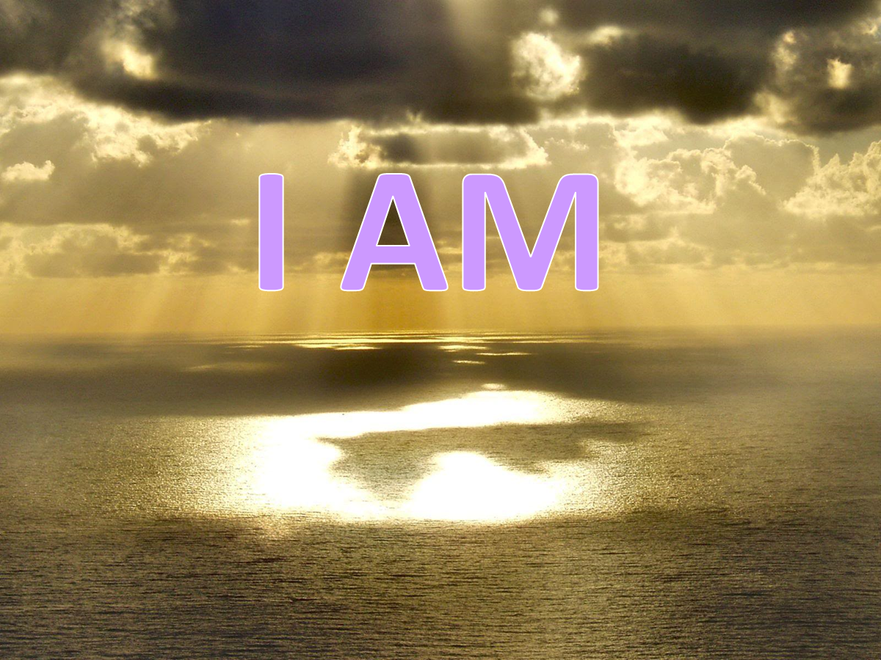
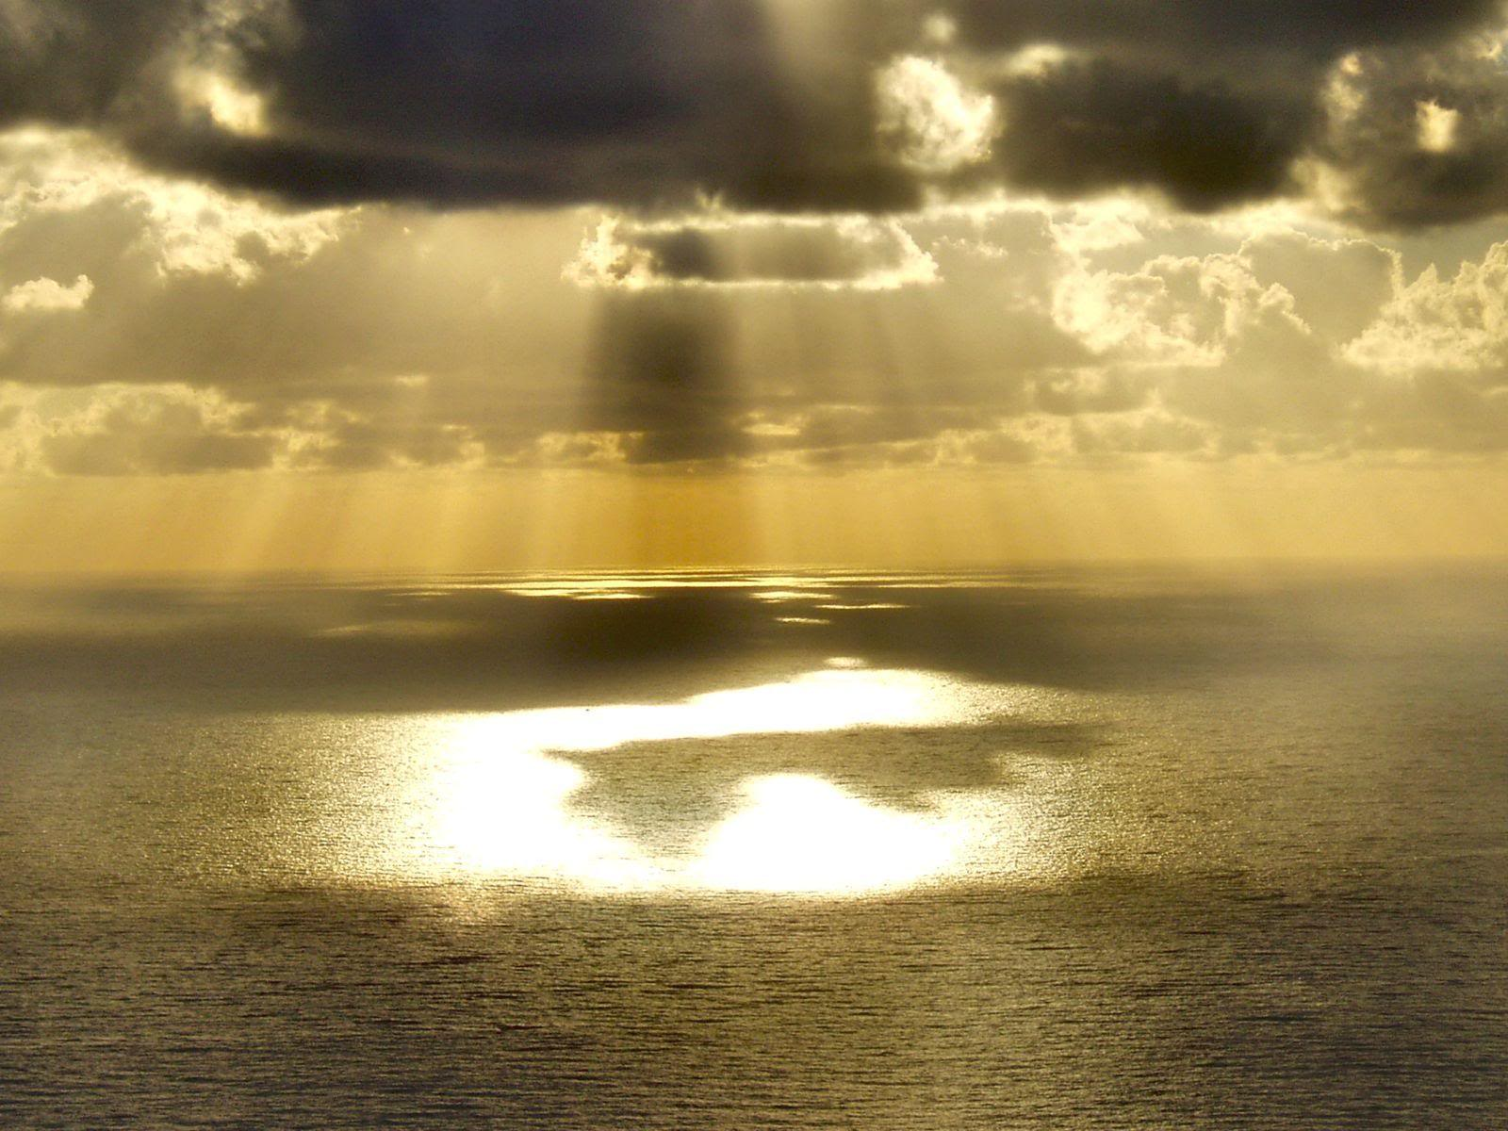
I AM
Ron Bert
December 25, 2017
Notes:
I am is identity of spirit.

Slide 3
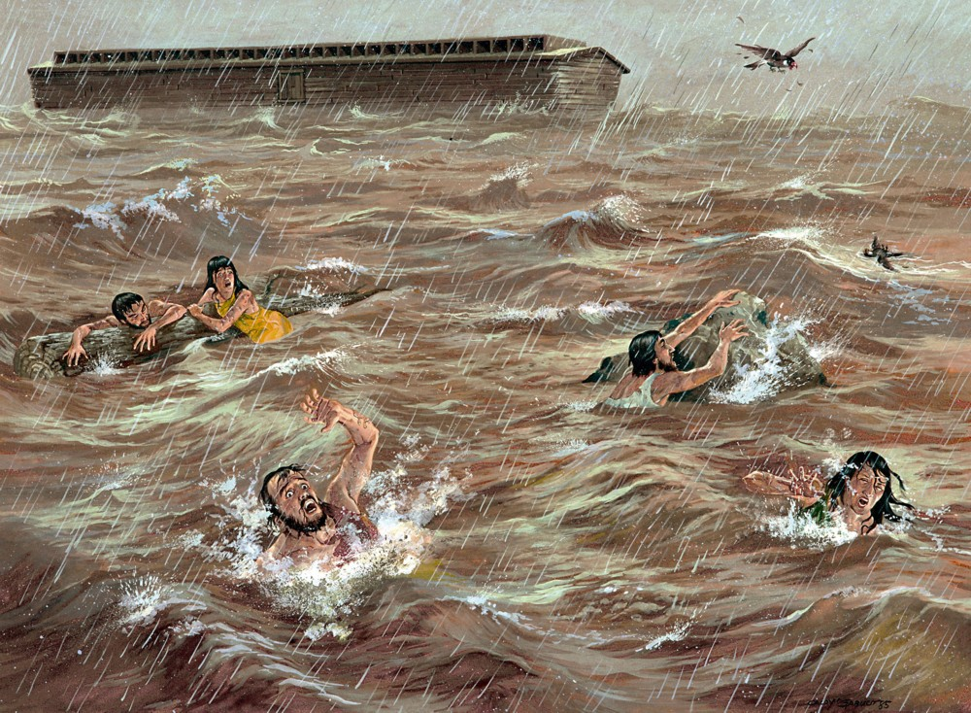
So the LORD said, "I will destroy man whom I have created from the face of the earth, both man and beast, creeping thing and birds of the air, for I am sorry that I have made them." — Genesis 6:7
I am
I am sorry
I am
Notes:
So despicable were people that they only desired evil seeking only selfish pursuits. I am is a sense of identity and goodness is part of this, or not, as a matter of character. God’s reflection of His identity was all but a memory lost. Love for others is the beginning of the miracle of living and what He bestows upon His creation. Without such, mutual love, bonding with His creation had no unity, leaving God hurt for witnessing such unloving creatures. This trend of mean intents has been the plague of all generations. Regret is one of the emotions God gives us in hopes we turn back to righteousness.

Slide 4
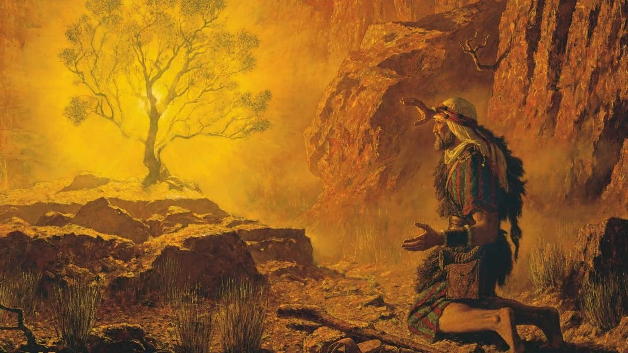
And God said to Moses, "I AM WHO I AM." And He said, "Thus you shall say to the children of Israel, 'I AM has sent me to you.'" — Exodus 3:14
God
I AM
God
I AM
I AM
I am
I AM
Notes:
The light of His love has healing shine for all that would hear.

Slide 5
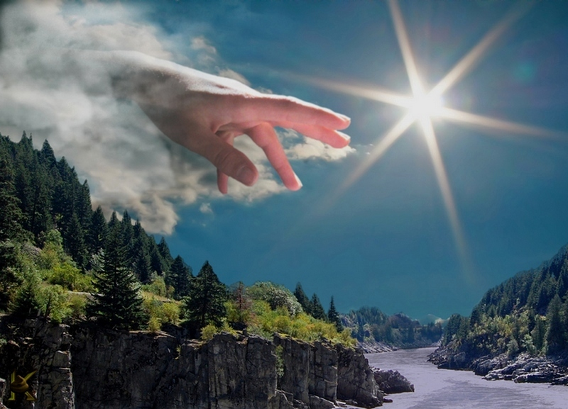
'Now see that I, even I, am He, And there is no God besides Me; I kill and I make alive; I wound and I heal; Nor is there any who can deliver from My hand.' — Deuteronomy 32:39
I
am
God
I am
deliverance
Notes:
His power exceeds anything one could perceive; unsurpassable. In a realm of diminishing substance, He rises past all in a greater way yet to be revealed. The material is a test of how each one’s character will respond. Deliverance is only had by His hand.

Slide 6
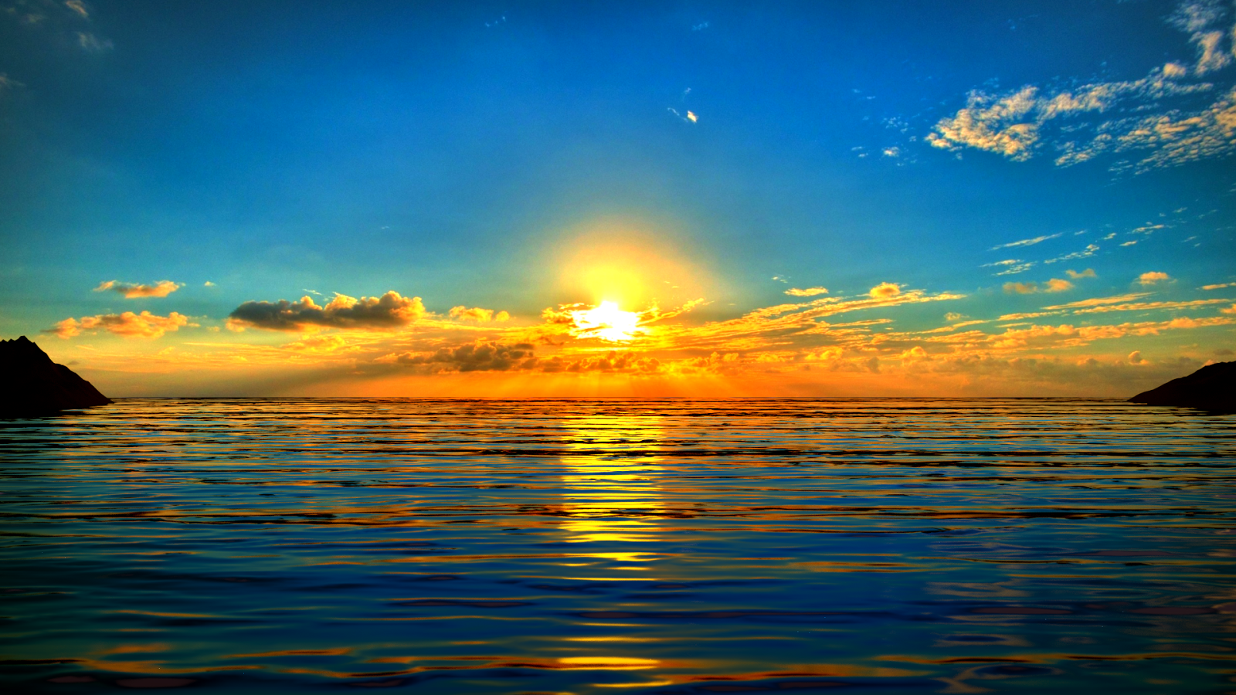
Be still, and know that I am God; I will be exalted among the nations, I will be exalted in the earth! — Psalms 46:10
I
I am
am
I
am
I will be exalted
in
Notes:
The extent of His calm places reflection upon our hearts to see deeper than just the surface. In a universe of limitations He shows us helplessness without Him. In our fallen sate we cannot even walk on water. Our lives fragilely transport in a hostile environment. His warning call to return, to that which is above, is ever clear in all the natural wonders we witness. This universe was made so that the divine nature would be more than apparent to those who would see it for what it is, His nursery.

Slide 7
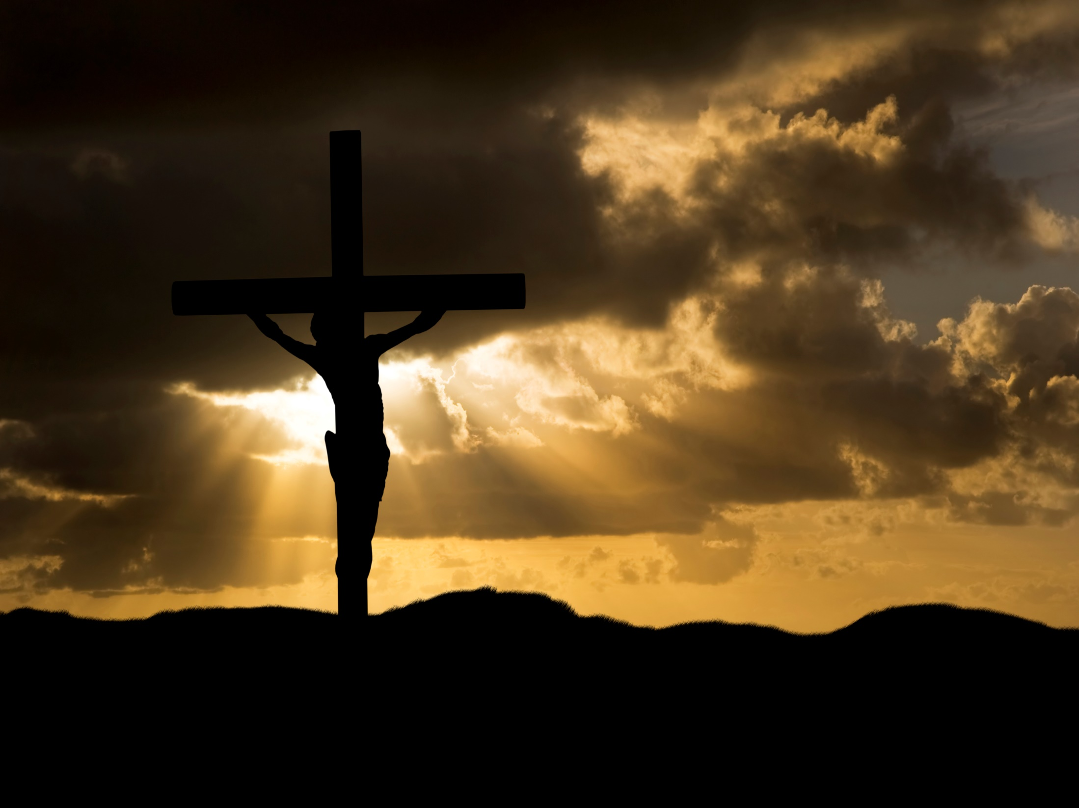
"I, even I, am the LORD, And besides Me there is no savior." — Isaiah 43:11
I, even I, am
I, even I, am
I
am
Notes:
The depth of His love digs searching for our return through His sacrifice.

Slide 8
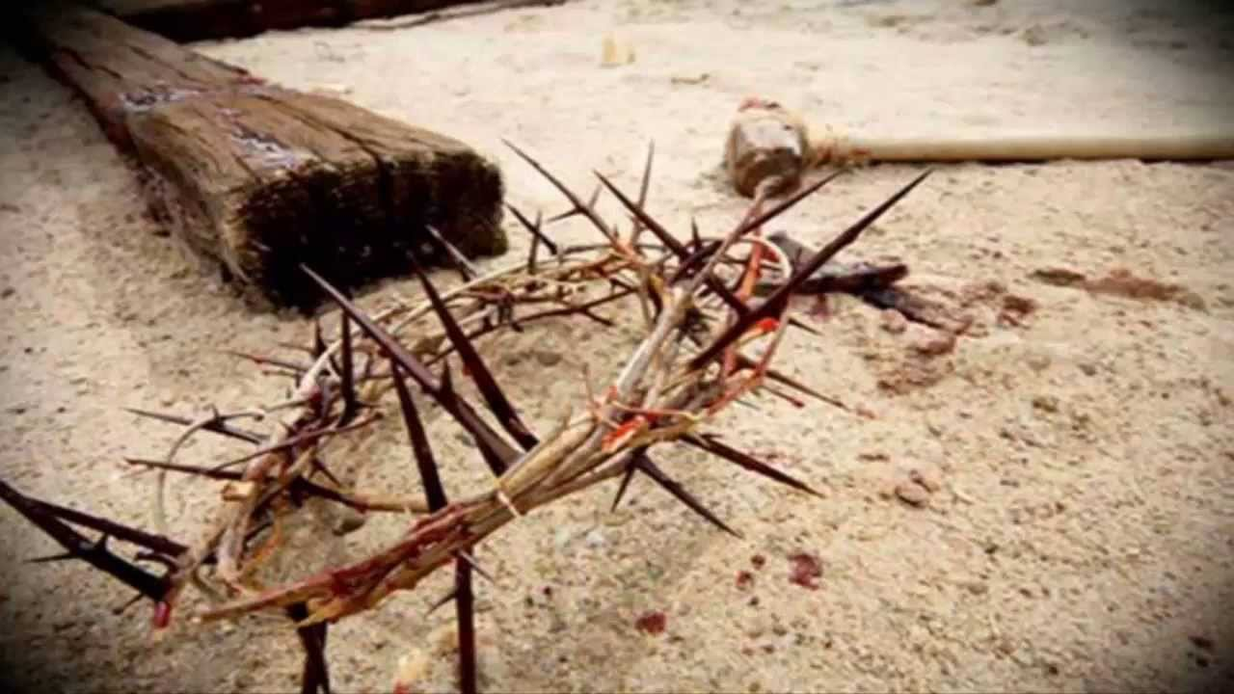
"I, even I, am He who blots out your transgressions for My own sake; And I will not remember your sins." — Isaiah 43:25
I, even I, am
I
am
I am
Notes:
He holds the spike of our sins. Redemption comes to those giving Him the highest in all gratitude.

Slide 9
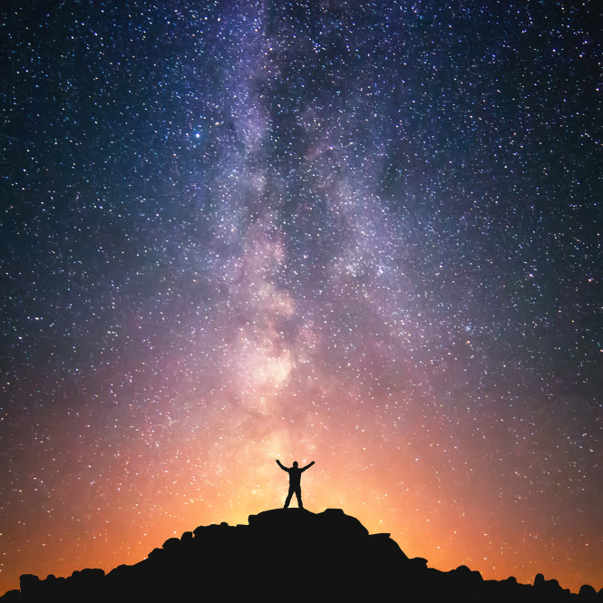
For thus says the LORD, Who created the heavens, Who is God, Who formed the earth and made it, Who has established it, Who did not create it in vain, Who formed it to be inhabited: "I am the LORD, and there is no other. — Isaiah 45:18
vain
futile
useless
unsuccessful
hopeless
unproductive
I am
I am
Notes:
Across the whole universe He is there. Will we be able to cross the divide of division to where love holds life in peace?

Slide 10
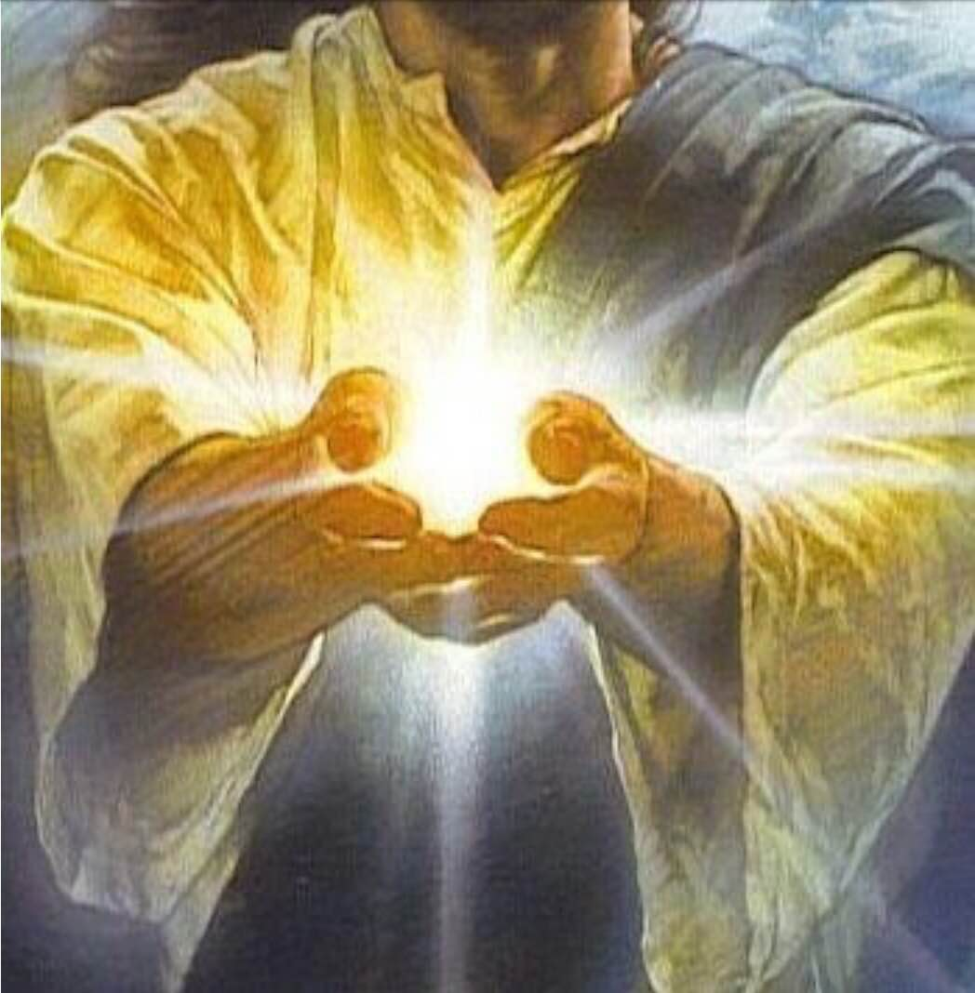
"Look to Me, and be saved, All you ends of the earth! For I am God, and there is no other. — Isaiah 45:22
I am
I am
Notes:
God wants us to rise in His light.

Slide 11
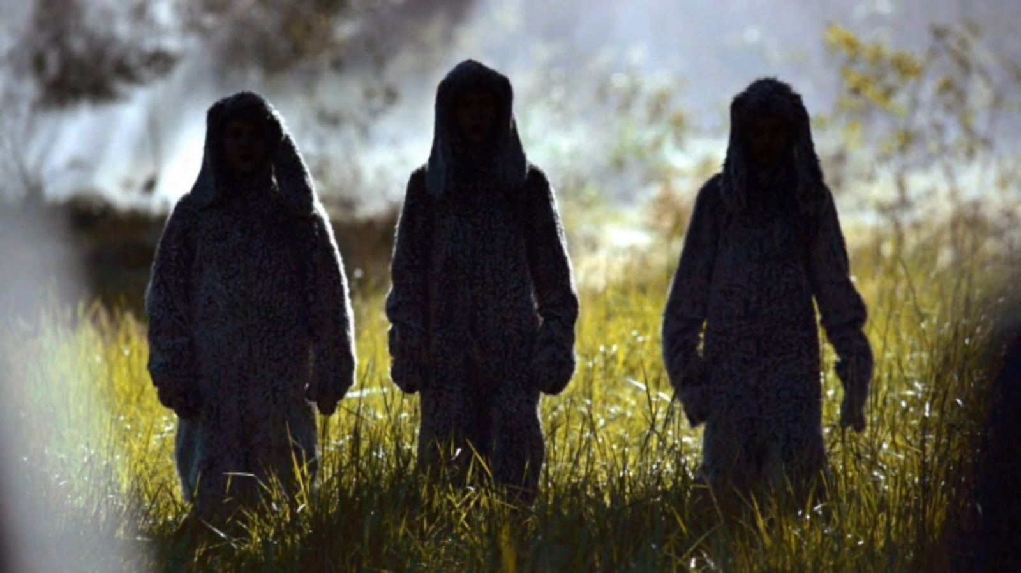
'Thus says the Lord GOD: "Behold, I am against the shepherds, and I will require My flock at their hand; I will cause them to cease feeding the sheep, and the shepherds shall feed themselves no more; for I will deliver My flock from their mouths, that they may no longer be food for them." ' — Ezekiel 34:10
I am
oppressors
I am
deliver
Notes:
Remember how the Lord was sorry He had made man, with all the evil that ensued? He continued even afterward (Noah) to have frustrations with man as he fell back into evil (disobedience). And so we are today. For those that would oppress others, God has reserved punishment. Darkness will lose its’ power over the humble of heart, no matter how dark that heart has come to be. God has the power to reach down to the bottom and is where He calls out the loudest.

Slide 12
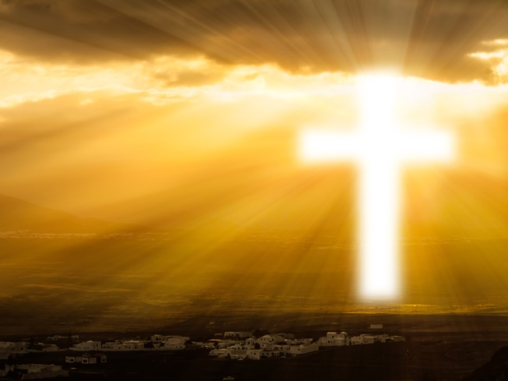
"It shall be, in regard to their inheritance, that I am their inheritance. You shall give them no possession in Israel, for I am their possession." — Ezekiel 44:28
in
I am their
I am
inheritance
I am
I am
I am
their possession
Notes:
Jesus Christ is our inheritance and possession into eternal life. In truth, it is the freedom of heart, and soul, He gives to rise past earth’s on goings. The inheritance God has given to us all is knowledge of Himself and an offering to return eternally. Earth is a halfway house searching to see our character of spirit be it noble or not. God wants to know if our values can rise above that of the mere material. This is a problem for us all in the physical. Many never come to even ask this most profound question especially if greed and lust is all that is known. Our desires declare our worship and direction in life. Together or apart defines a heart.

Slide 13
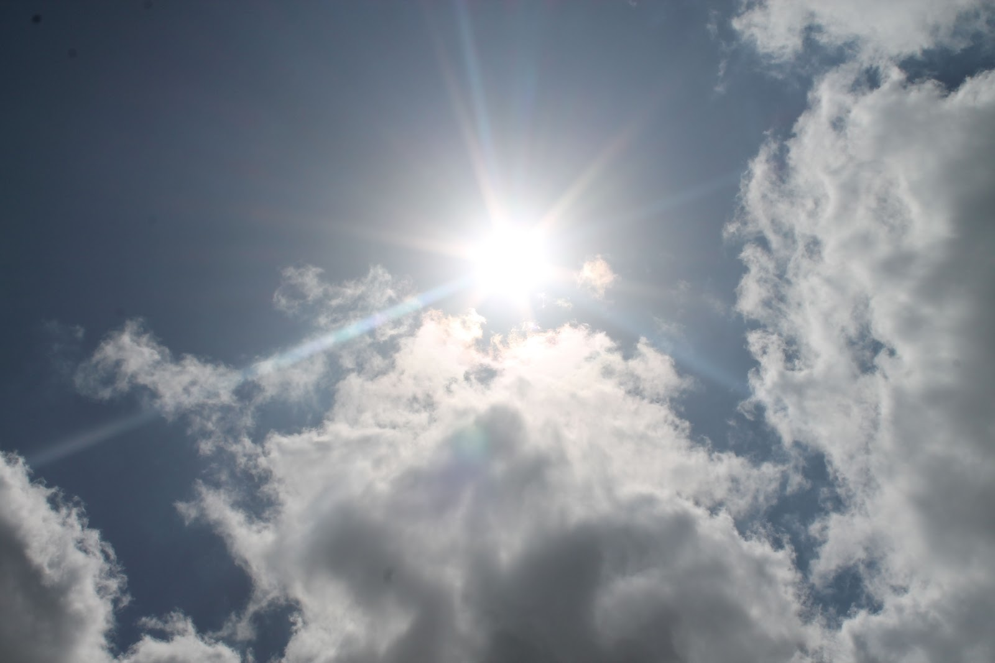
And suddenly a voice came from heaven, saying, "This is My beloved Son, in whom I am well pleased." — Matthew 3:17
I am
I am
Notes:
God in the balance has no argument against Himself. He came to us to give of Himself.

Slide 14
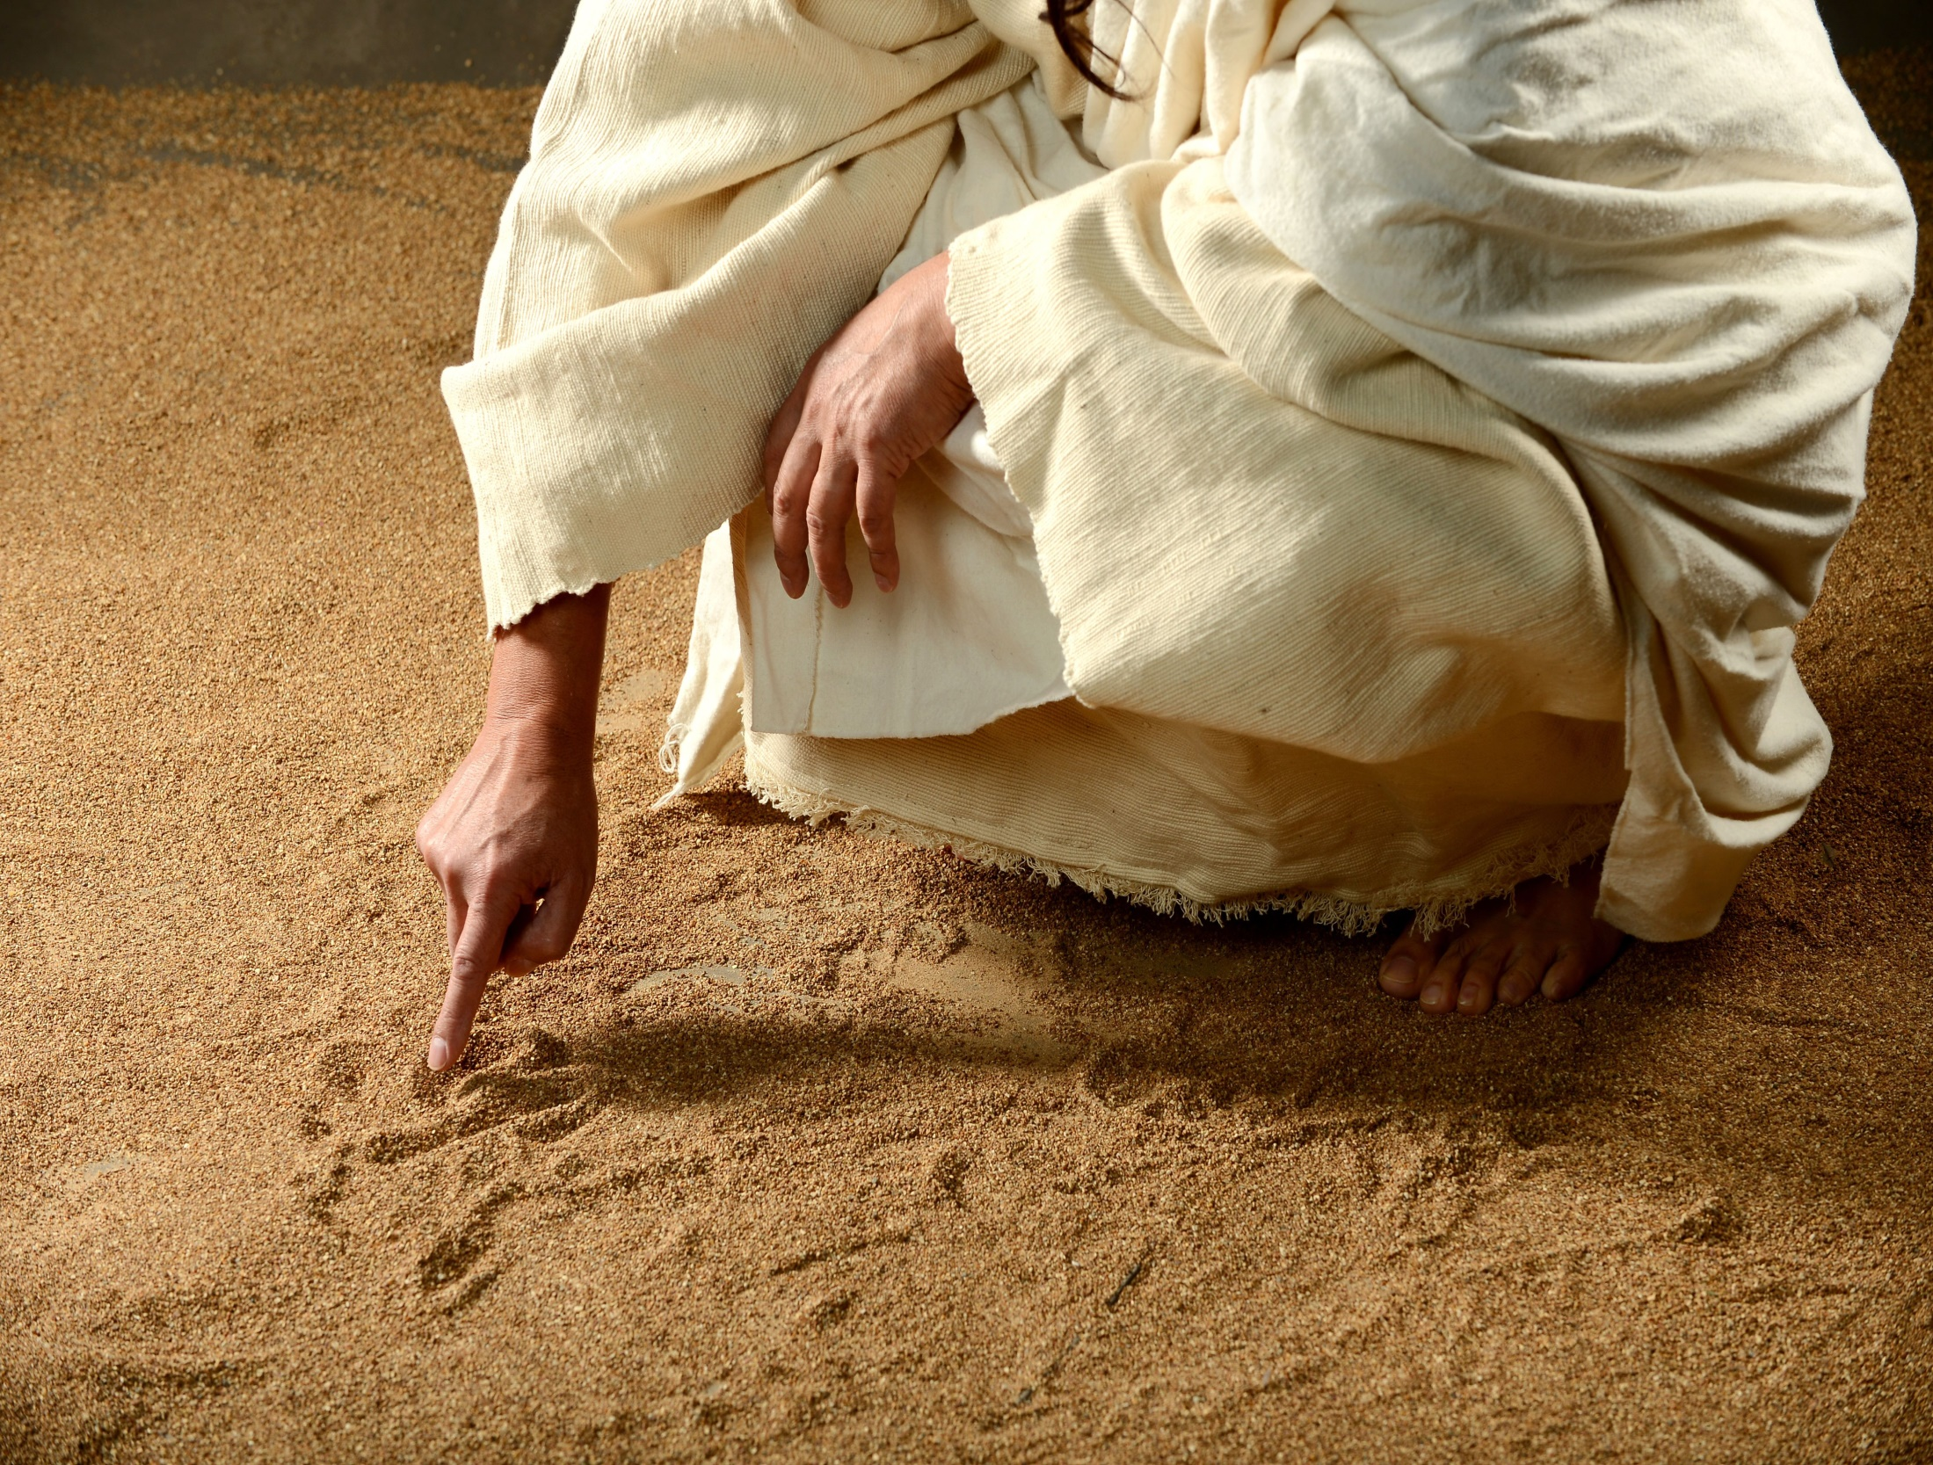
He said to them, "But who do you say that I am?" Peter answered and said to Him, "You are the Christ." Then He strictly warned them that they should tell no one about Him. — Mark 8:29-30
I am
I am
Notes:
All sand lays in the bosom of His creation. By His power all is at rest in time upon the wholeness of His substance. The secrets of His authority are past knowing.

Slide 15
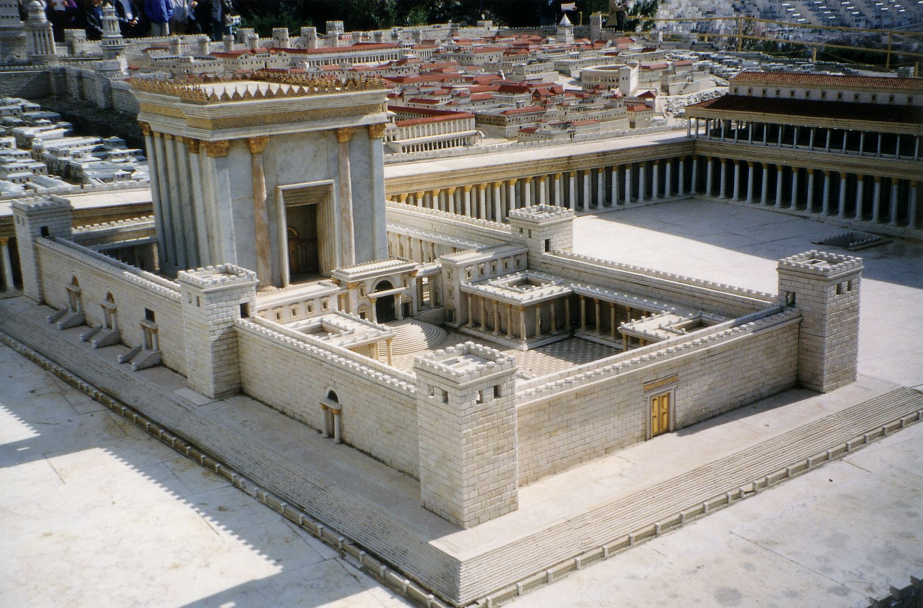
Then Jesus cried out, as He taught in the temple, saying, "You both know Me, and you know where I am from; and I have not come of Myself, but He who sent Me is true, whom you do not know. "But I know Him, for I am from Him, and He sent Me." — John 7:28-29
He taught
in
I am
I am
Notes:
Jesus came to the temple in Jerusalem to expose the true temple of God. That would be where the light of life would dwell, and His will was to wake mankind up to the fact that he himself (man) was created in the image of God, and to realize this would be to realize true life from within. We are the temples Jesus teaches in. Let your light shine has merit.

Slide 16
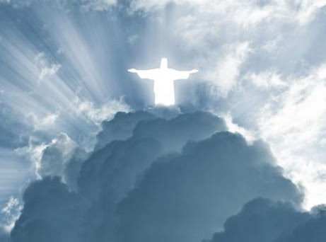
So the Jews said, "Will He kill Himself, because He says, 'Where I go you cannot come'?" And He said to them, "You are from beneath; I am from above. You are of this world; I am not of this world. Therefore I said to you that you will die in your sins; for if you do not believe that I am He, you will die in your sins." — John 8:22-24
I am
I am
I am
I AM
I am
do not believe
I am
die
in
Notes:
God has physically in the flesh extended Himself for us to know enough to make the choice of accepting Him, or believing something else which ends in mutual rejection. God does not change and if man changes Him (God) to fit sin, it will never be so. Religions of man cannot excuse the truth of God. In fact, many associations have the guise of religion but are actually infused with agendas of man for man, and man’s interests, over divine pursuits in Holy worship.

Slide 17
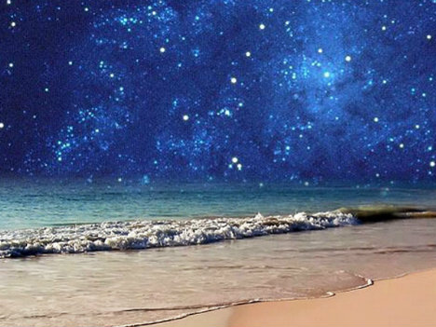
Jesus said to them, "Most assuredly, I say to you, before Abraham was, I AM." — John 8:58
I AM
Notes:
Jesus is on the shore of all that is. Not a blink has gone by that He does not know.

Slide 18
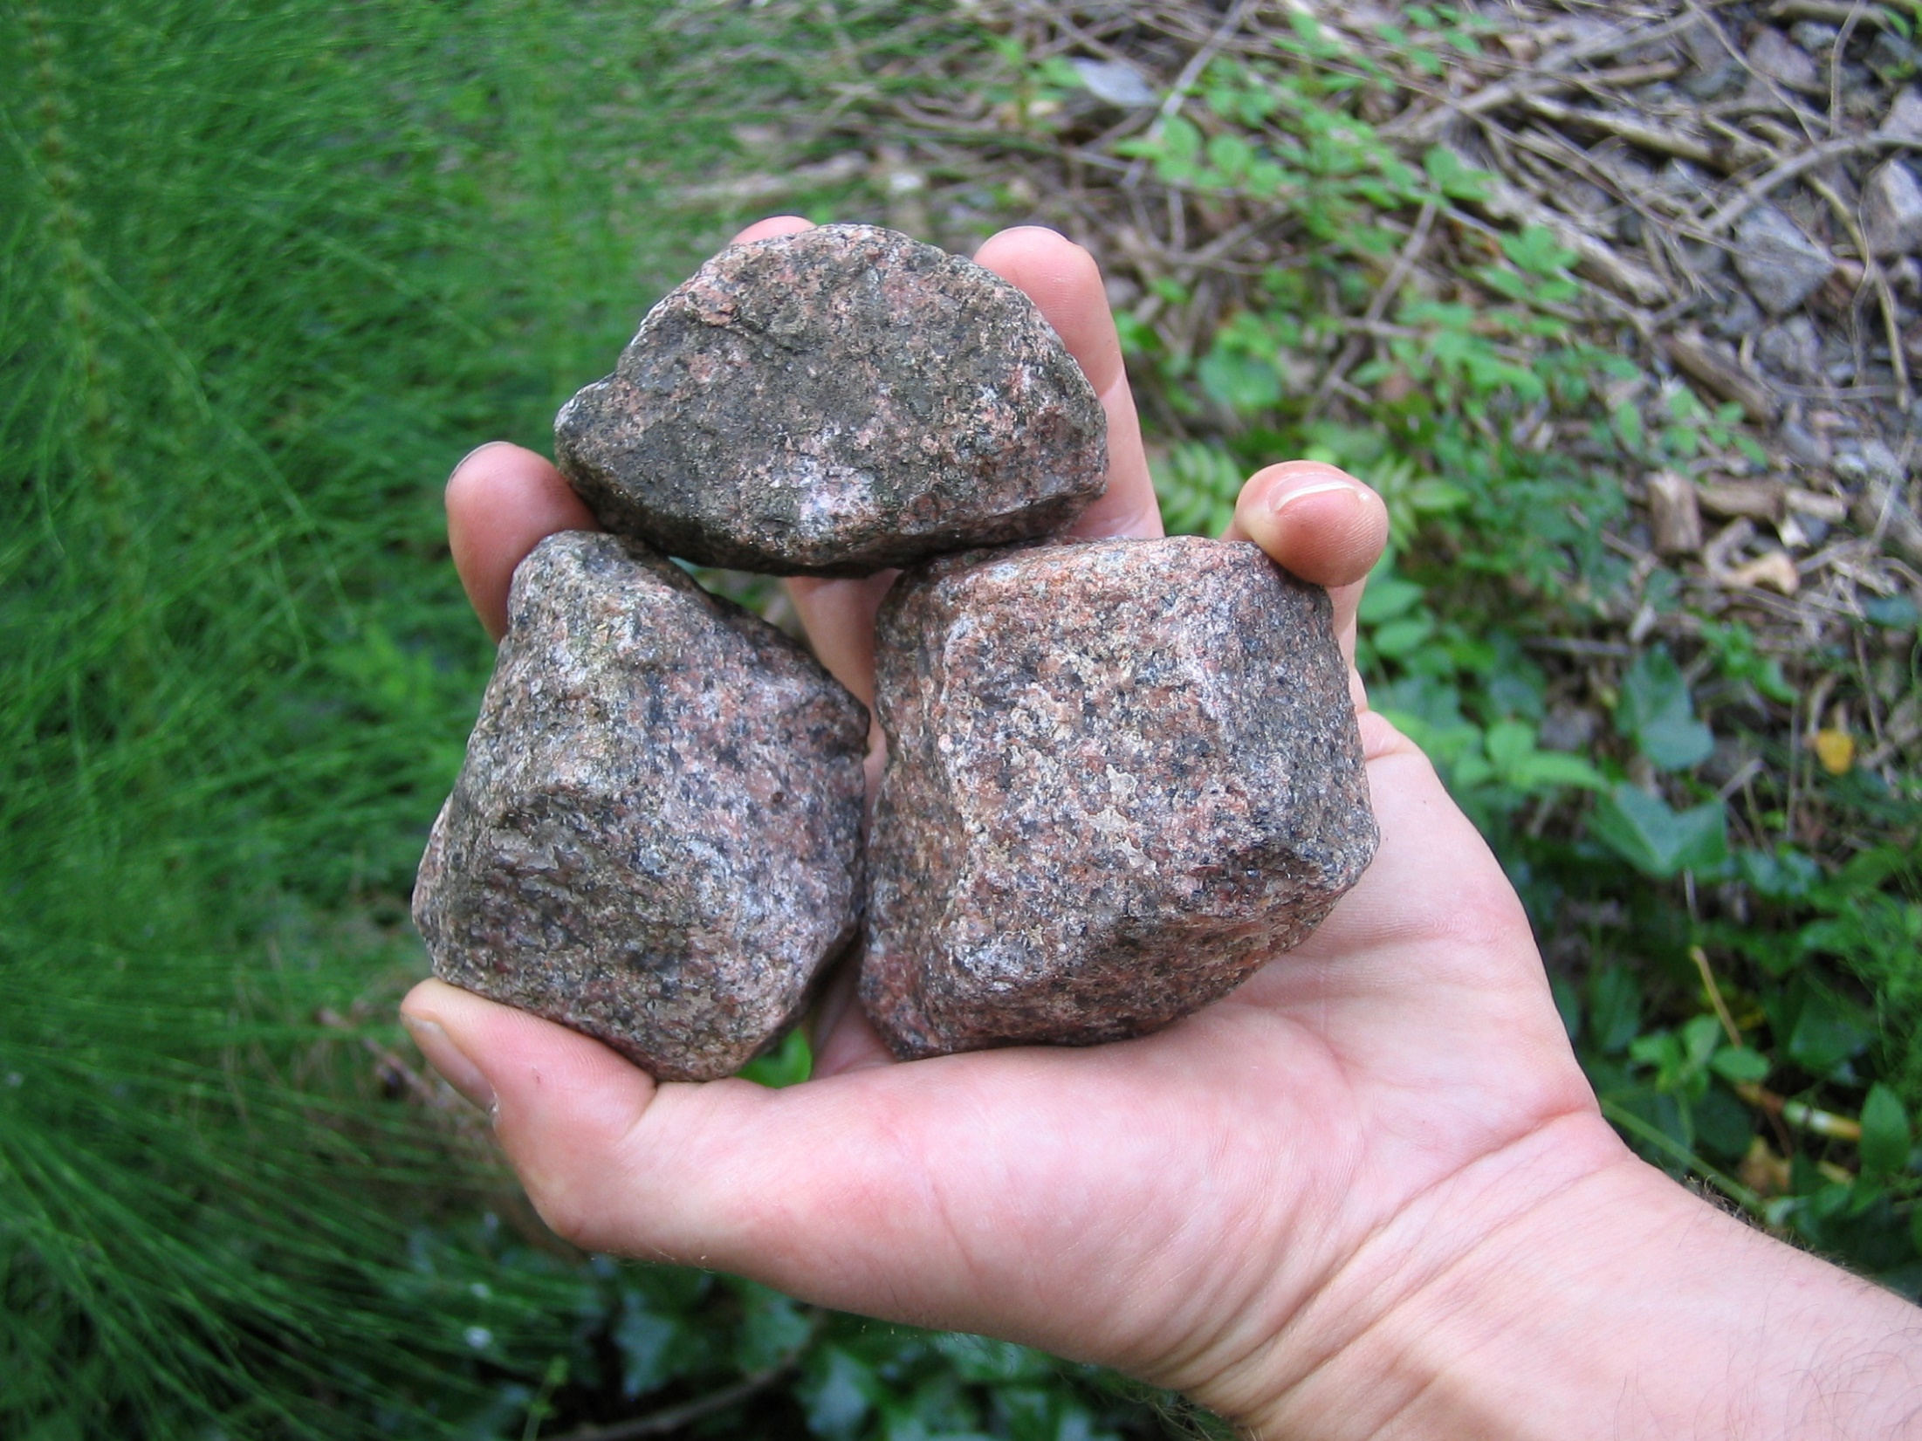
"I and My Father are one." Then the Jews took up stones again to stone Him. Jesus answered them, "Many good works I have shown you from My Father. For which of those works do you stone Me?" — John 10:30-32
I and My Father are one
work
work
Notes:
Jealousy has the power to turn against one’s own best friend; a sad statement of living in the flesh. Competing too often rides the prepared knife before commendations of praise pour forth. Jesus was despised for the good light that was in and of Him.

Slide 19
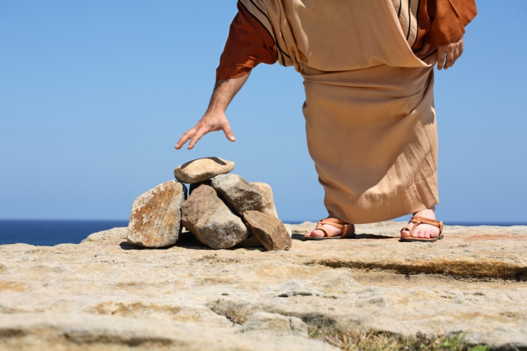
The Jews answered Him, saying, "For a good work we do not stone You, but for blasphemy, and because You, being a Man, make Yourself God." — John 10:33
work
God
God
Notes:
They could not kill Him for the good works, because they were all too fantastic, miraculous things which had no evil in them. But from their own inadequacies buried in anger, He had something they did not, He was acquiring the love and respect of the people. So symbolic that they wanted to kill God, so they as individuals could claim that honor for themselves, to be exalted as gods issuing judgment. It is a brave man that declares to be judge, jury, and executioner, in the face of God Himself.

Slide 20
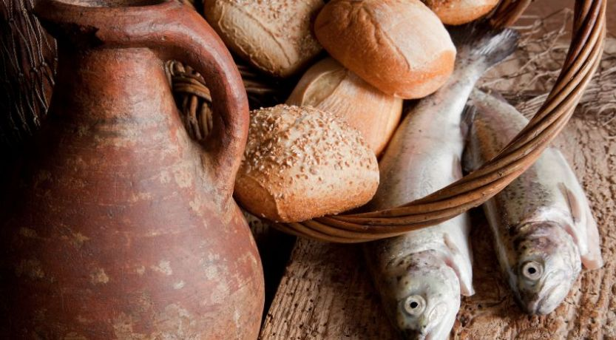
"... do you say of Him whom the Father sanctified and sent into the world, 'You are blaspheming,' because I said, 'I am the Son of God'? If I do not do the works of My Father, do not believe Me;" — John 10:36-37
works
God
works
Notes:
They were seething so hard to kill Jesus for His works, and all for that they were not capable on the same scale as He was. Truth, power, compassion, understanding over all, Jesus was here for all, even those that plotted against Him.

Slide 21
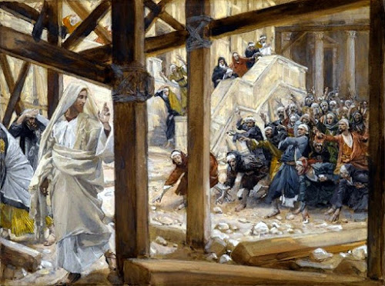
"... but if I do, though you do not believe Me, believe the works, that you may know and believe that the Father is in Me, and I in Him." Therefore they sought again to seize Him, but He escaped out of their hand. — John 10:38-39
Father in Me
believe the works
works
Father
in Me
Notes:
One of the great things Jesus did by coming to earth was to show how God Himself could be in you, in the goodness that He is, filling one’s heart just for the sake that He is, the Great and Almighty I AM. Love of God has remained with many across the eons of time. It can be found if sought after.

Slide 22
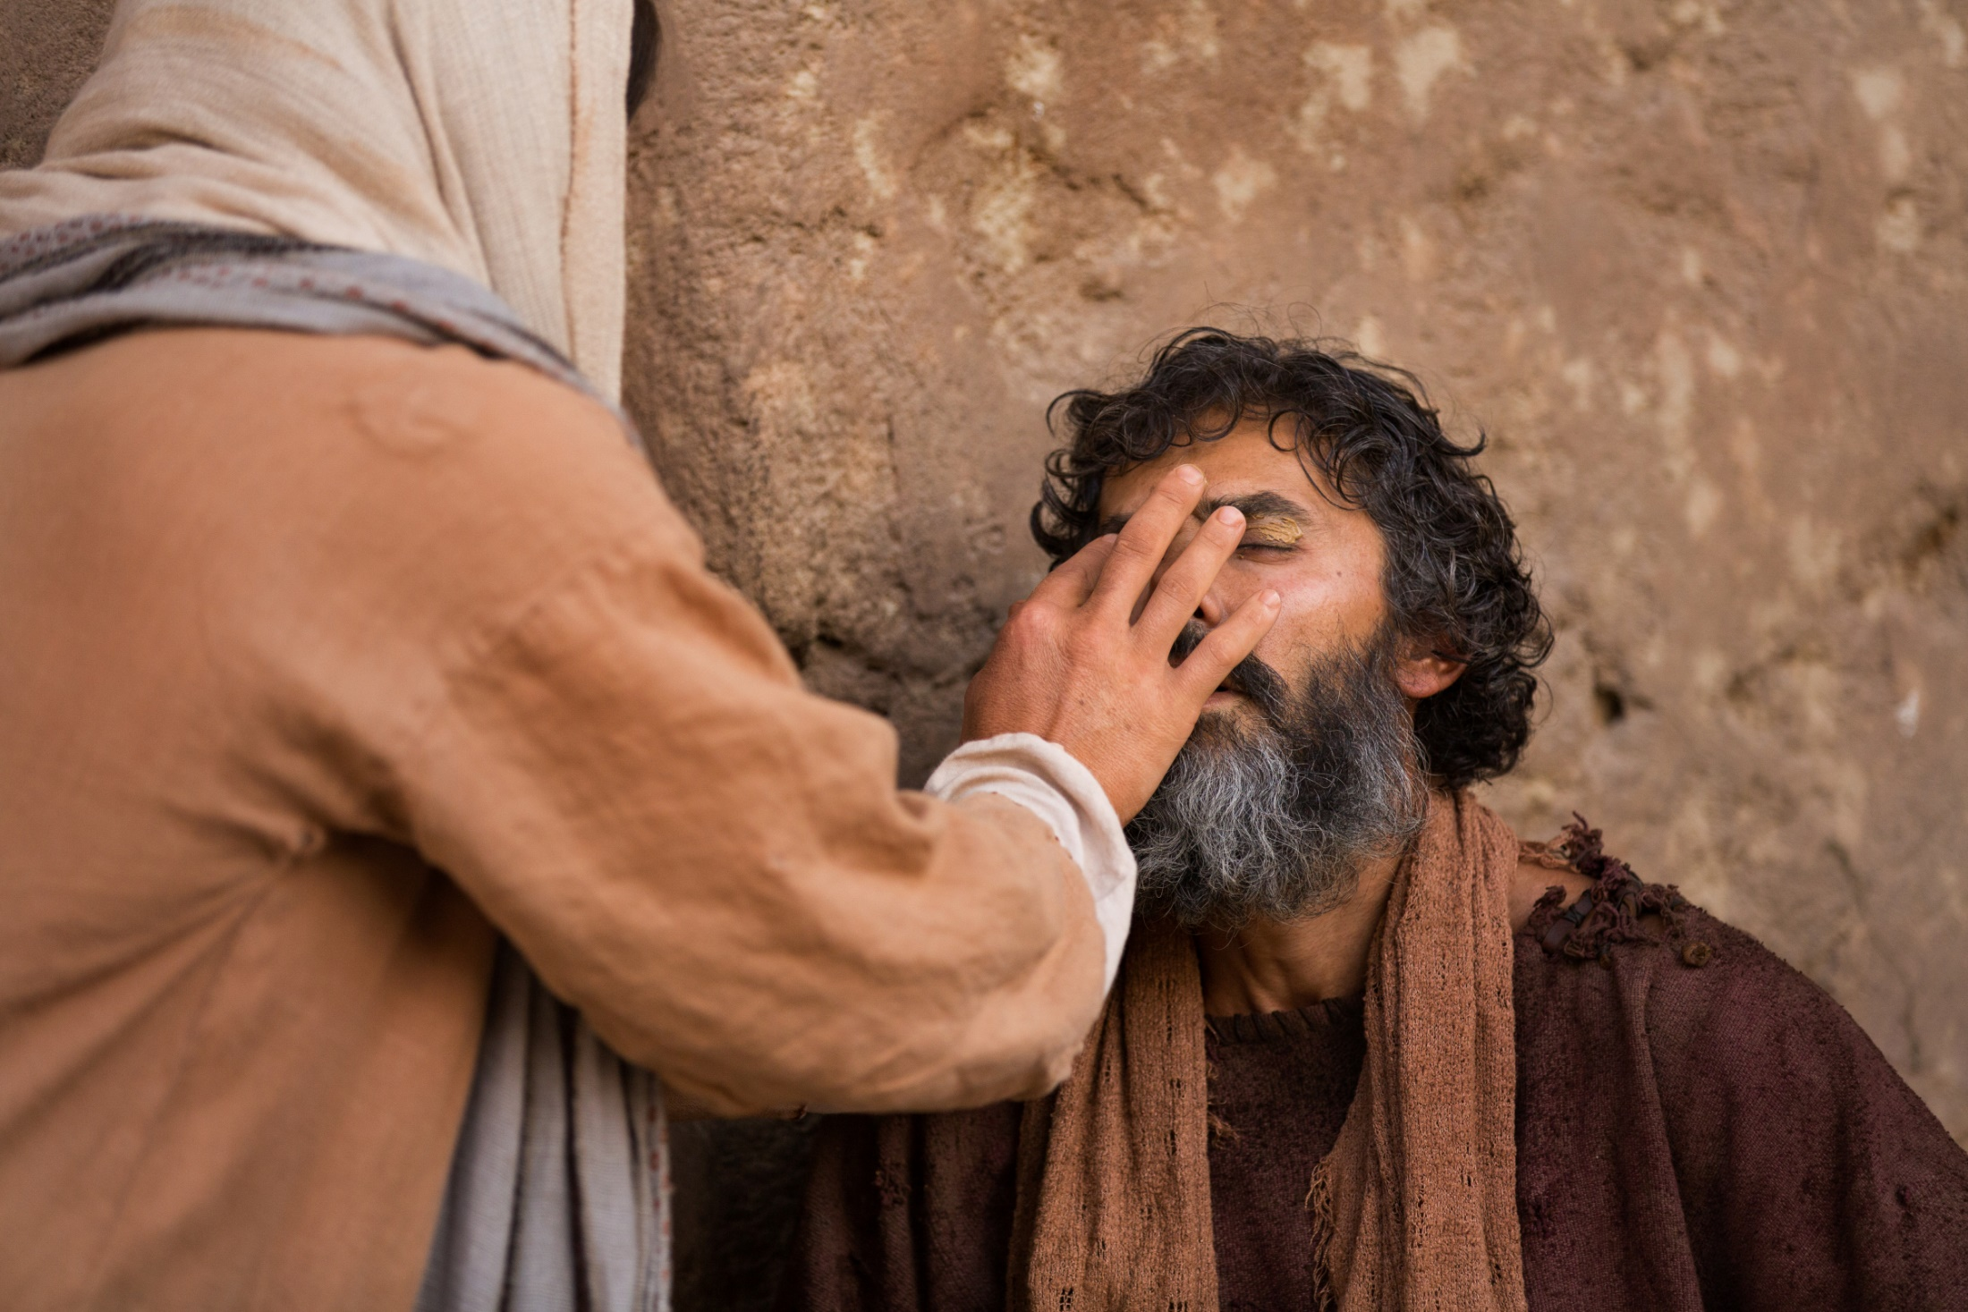
"Do you not believe that I am in the Father, and the Father in Me? The words that I speak to you I do not speak on My own authority; but the Father who dwells in Me does the works. Believe Me that I am in the Father and the Father in Me, or else believe Me for the sake of the works themselves. — John 14:10-11
believe
I am
in
in Me
Father in Me
Father
Father
I am
Father
Father
in Me
Believe Me
Father
Father
in Me
believe Me
Notes:
Jesus showed something wonderful and separate from any and all afflictions suffered by man. It was God’s example for man in how His creatures should care for one another, and not through judgmental and contemptuous hearts.

Slide 23
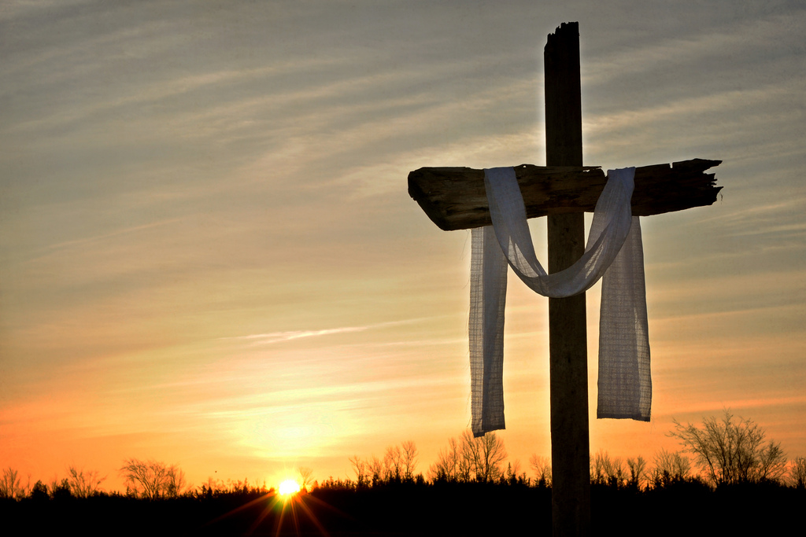
"A little while longer and the world will see Me no more, but you will see Me. Because I live, you will live also. At that day you will know that I am in My Father, and you in Me, and I in you. He who has My commandments and keeps them, it is he who loves Me. And he who loves Me will be loved by My Father, and I will love him and manifest Myself to him." — John 14:19-21
I am in My Father
I am
I am in My
you in Me, and I in you
Father
you in Me, and I in you
you in Me, and I in you
Notes:
He is the light that guides us home, to that eternal sanctuary, where His love is supremely welcomed endlessly with no moment to spare. It is that Jesus is in the Father, and He is in us, and we in Him, that is the light of truth from within.

Slide 24
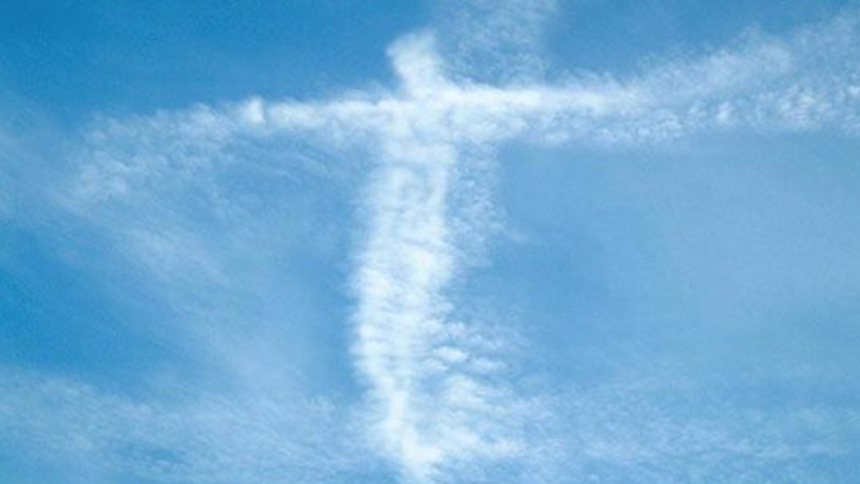
→ I am sorry that I have made them
→ I AM WHO I AM
→ Be still, and know that I am God
→ I am the LORD, And besides Me there is no savior
→ I am He who blots out your sins for My own sake
→ I am their inheritance & I am their possession
→ My beloved Son, in whom I am well pleased
→ I know Him, for I am from Him, and He sent Me
→ I am from above; I am not of this world
→ If you do not believe I am He, you will die in your sins
→ Before Abraham was, I AM
→ Believe Me that I am in the Father & the Father in Me
→ I am in My Father, and you in Me, and I in you
We are in Him,
the Great I AM
Notes:
He is so we are in Him, the Great I AM

Slide 25
Notes:
Darkness has no expression of grace.

Slide 26
I AM
2
Ron Bert
December 25, 2017
Notes:
In the ocean of time, I am is the greatest that all could be. Identity is God and His gift unto life upon His creation.

Slide 27
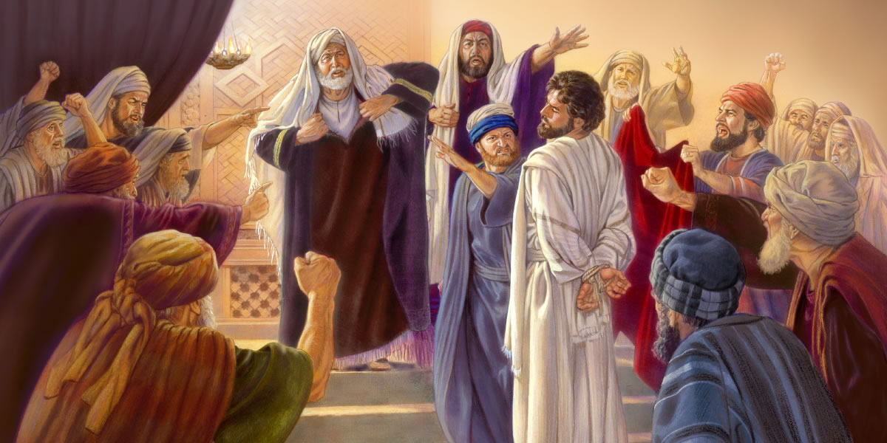
But He kept silent and answered nothing. Again the high priest asked Him, saying to Him, "Are You the Christ, the Son of the Blessed?" Jesus said, "I am. And you will see the Son of Man sitting at the right hand of the Power, and coming with the clouds of heaven." — Mark 14:61-62
I am
I am
Notes:
Jesus could say nothing to convince the hateful religious elite to love where they could not. A symptom of pride is a hardened heart.

Slide 28
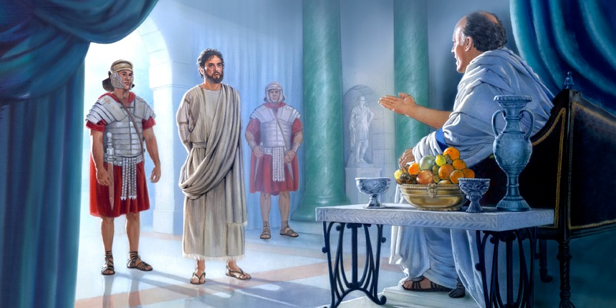
Pilate therefore said to Him, "Are You a king then?" Jesus answered, "You say rightly that I am a king. For this cause I was born, and for this cause I have come into the world, that I should bear witness to the truth. Everyone who is of the truth hears My voice." — John 18:37
You say rightly that I am a king
I am
Notes:
Pilate had the illusion of power and found himself dumbfounded at the meek straightforwardness that Christ possessed.

Slide 29
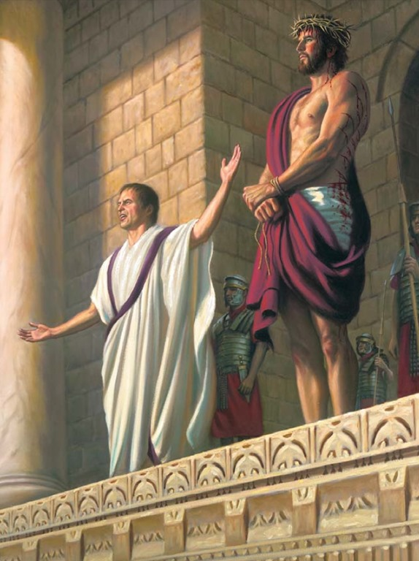
So they cried out again, "Crucify Him!" Then Pilate said to them, "Why, what evil has He done?" But they cried out all the more, "Crucify Him!" — Mark 15:13-14
what evil has He done?
Notes:
Relinquishing his own good judgment, Pilate chose to be a crowd pleaser instead. Cowardice is common to man no matter how high one is. Little did anyone know Christ was the sacrifice for all men including Pilate. Ingenious was God’s plan to reach out past His physical form on earth to appeal exactly as He would have it to all those that would find His salvation in truth. God presented Himself as the most honorable lowly loving man alive in a world consumed by hate. His life, death, and resurrection is our example on numerous surrounding levels explaining present eternal life in Him. The innocent often stand afar off in shock while evil plays out its’ gruesome deeds. Without fear of God, respect for one another is out of reach.

Slide 30
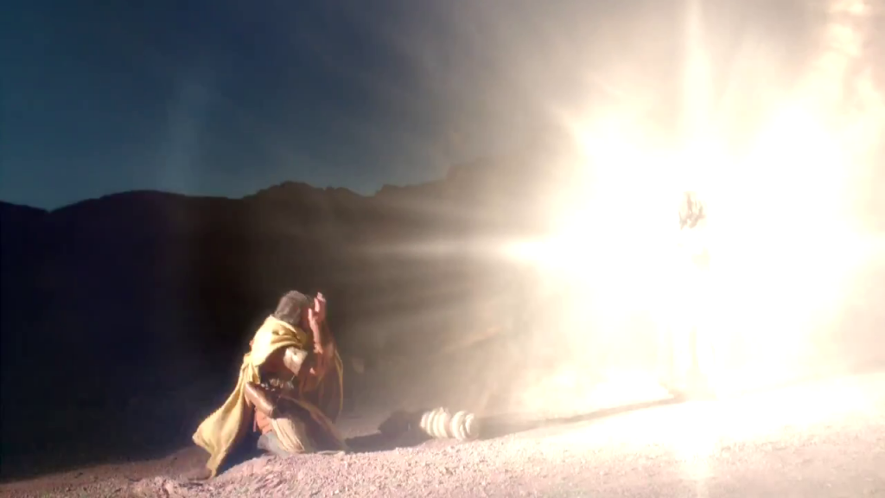
And he said, "Who are You, Lord?" Then the Lord said, "I am Jesus, whom you are persecuting. It is hard for you to kick against the goads." — Acts 9:5
I am
I am
Notes:
Above all, we learn from scripture that Jesus was and is the personification of light in love itself holding justice as reserved. In His resurrection He continued to suffer for the truth to be known over the evil practices of the selfish mired in ignorance.

Slide 31
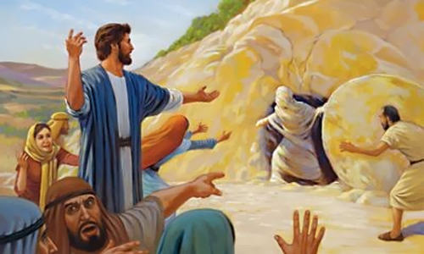
Jesus said to her, "I am the resurrection and the life. He who believes in Me, though he may die, he shall live." — John 11:25
I am
I am
believes in Me
in
Notes:
All God wants is for His creation in life to remain alive. God expects love for love and respectful acknowledgement, which He is more than magnanimously due. Disregarding God is the face that confronts our current physical circumstance. As noticed in the fading night sky is a sign given, rebellion has the material consequences of evaporating in to the voids of nothing. Remembrance (awakening) has the rising sign of life during the visible day in His light.

Slide 32
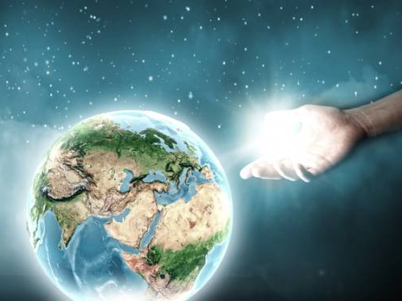
"But concerning the resurrection of the dead, have you not read what was spoken to you by God, saying, 'I am the God of Abraham, the God of Isaac, and the God of Jacob'? God is not the God of the dead, but of the living." — Matthew 22:31-32
I am
I am
of the living
Notes:
Life is universally eternal, no need to search for it as it is already here.

Slide 33
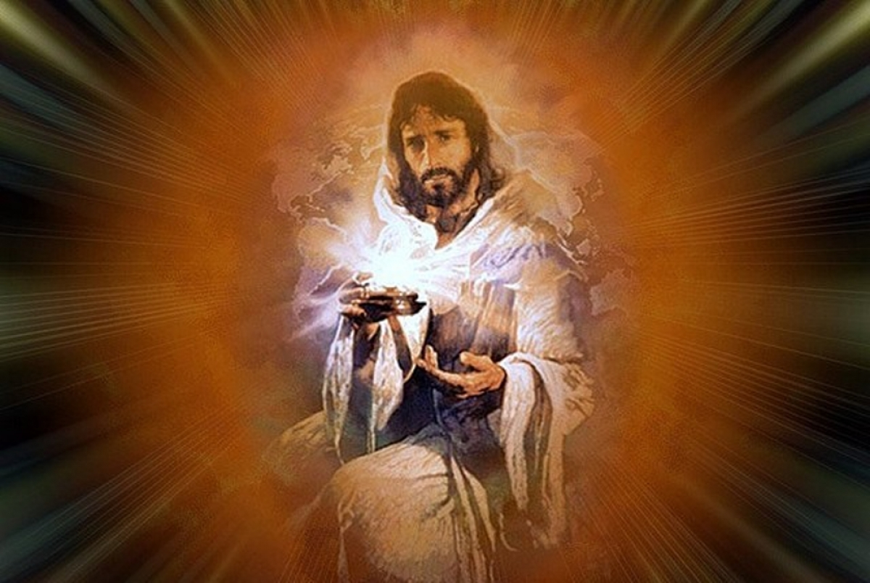
And Jesus said to them, "I am the bread of life. He who comes to Me shall never hunger, and he who believes in Me shall never thirst. — John 6:35
I am
source
I am
believes in Me
Notes:
God is the substance of all of our lives. He is the one that continually refreshes life. In His call to us He offers the body of His life openly.

Slide 34
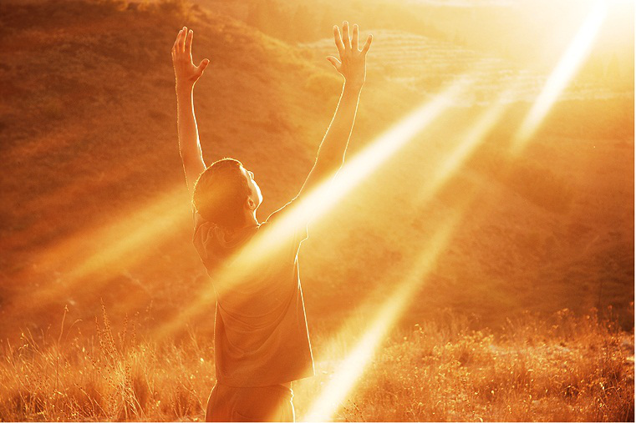
Then Jesus spoke to them again, saying, "I am the light of the world. He who follows Me shall not walk in darkness, but have the light of life." — John 8:12
I am
I am
follows Me
light of life
Notes:
Jesus brought to us a light brighter than the sun; creation of life itself. Without following Jesus and His ways, many become or remain plagued with depression, anger, jealousies and or envies of this or that. Truly the light He gives is life itself.

Slide 35
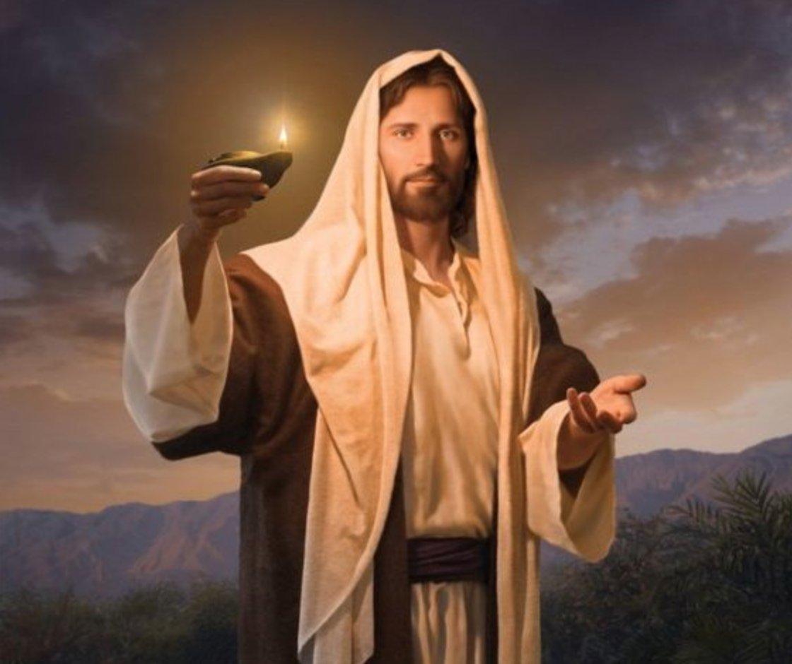
"As long as I am in the world, I am the light of the world." — John 9:5
I am
I am
I am
I am
Notes:
Jesus is the road map back to God and all other doctrines lack credibility, no matter how loud they scream foul. God will not coexist with evils created by men demanding tolerance as He Himself has shown His wrath will come upon the disobedient. No excuse will excuse one from the coming judgment in the light of His truth. Christianity is God reaching down for man and all else is man reaching for man.

Slide 36
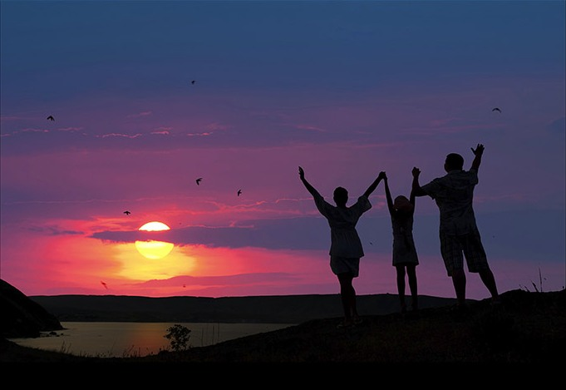
"For where two or three are gathered together in My name, I am there in the midst of them." — Matthew 18:20
I am
I am
Notes:
He is the psychic web of truth that binds spirits together.

Slide 37
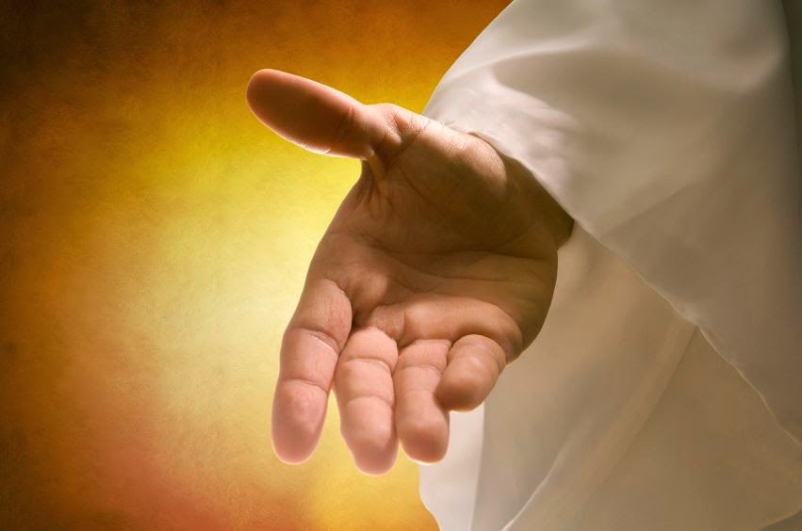
"Come to Me, all you who labor and are heavy laden, and I will give you rest. Take My yoke upon you and learn from Me, for I am gentle and lowly in heart, and you will find rest for your souls. For My yoke is easy and My burden is light." — Matthew 11:28-30
I am
in
I am
Notes:
Feathers of love float in His kingdom where light propels them upon the winds of truth. Past the weight of all the universe is where God resides.

Slide 38
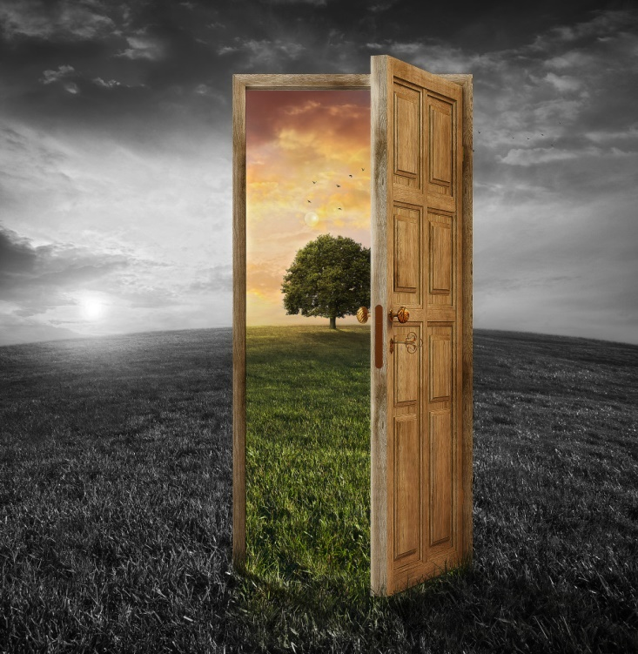
Then Jesus said to them again, "Most assuredly, I say to you, I am the door of the sheep. All who ever came before Me are thieves and robbers, but the sheep did not hear them. I am the door. If anyone enters by Me, he will be saved, and will go in and out and find pasture." — John 10:7-9
I am
I am
I am
enters by Me
saved
Notes:
Who in their right senses would not want to enter through the door to eternity? It can only be achieved by submitting to the will of God in truth and spirit. He has proclaimed it.

Slide 39
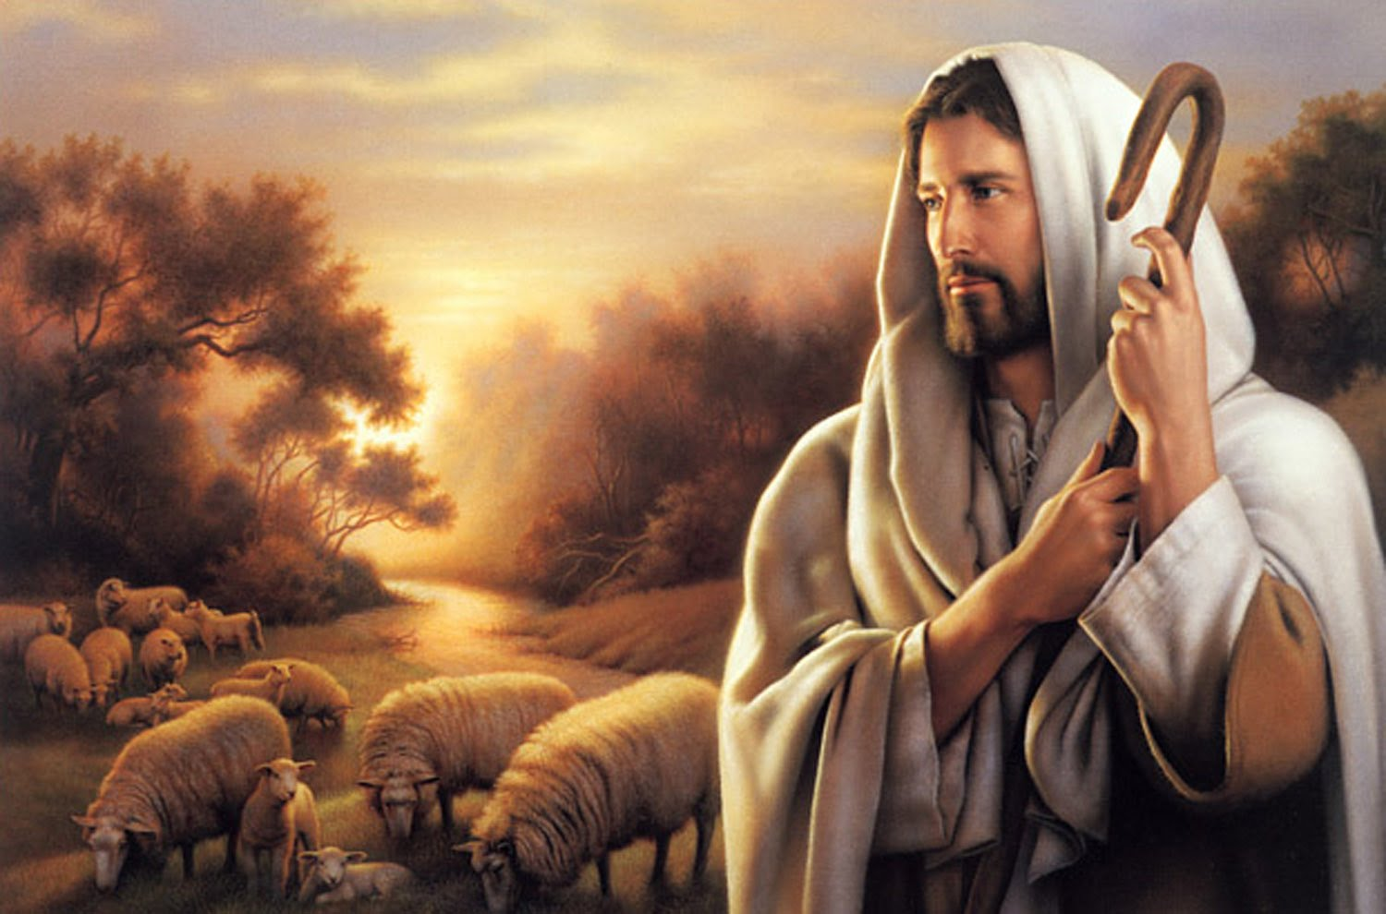
"The thief does not come except to steal, and to kill, and to destroy. I have come that they may have life, and that they may have it more abundantly. I am the good shepherd. The good shepherd gives His life for the sheep." — John 10:10-11
life
I am
more abundantly
I am
Notes:
To be ready is to know He is coming and to act upon this knowledge.

Slide 40
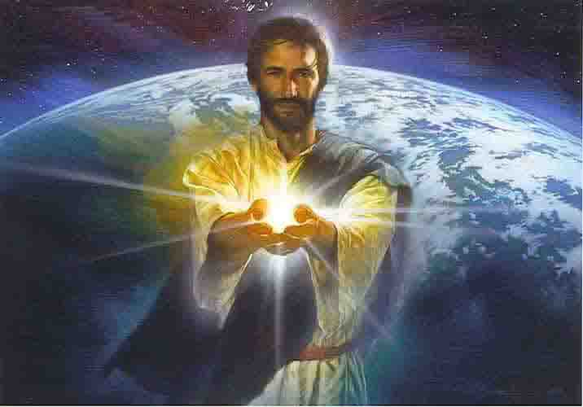
"You call me Teacher and Lord, and you say well, for so I am." — John 13:13
I am
I am
Notes:
Jesus is not the demon many have declared. He should not be despised as He came to instruct us how to reach out with genuine hearts, justified in His sight, offering salvation from sin. His teachings can be the hardest to apply where goodness is paramount.

Slide 41
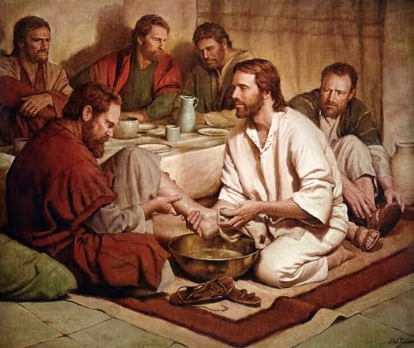
"For who is greater, he who sits at the table, or he who serves? Is it not he who sits at the table? Yet I am among you as the One who serves." — Luke 22:27
I am
I am
serves
Notes:
God is the servant of all.

Slide 42
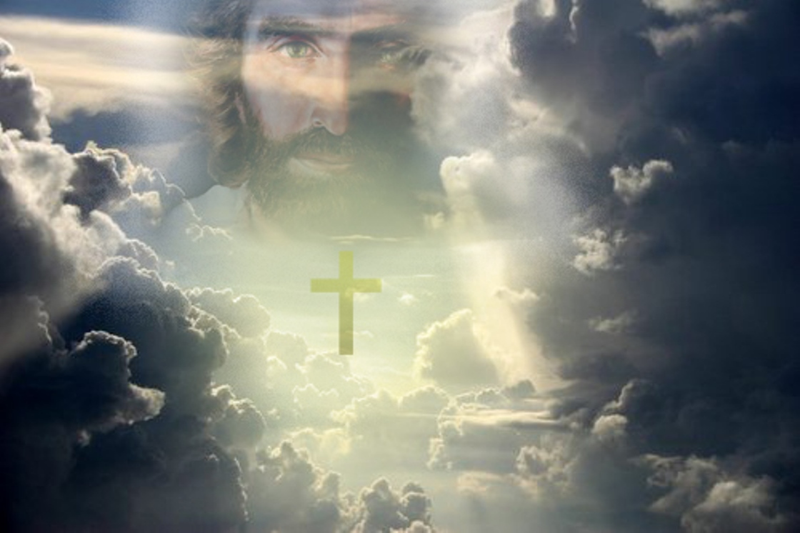
"And if I go and prepare a place for you, I will come again and receive you to Myself; that where I am, there you may be also." — John 14:3
I am
I am
you may be
Notes:
Out of the womb of the earth will come His glory rising into a wondrous eternal kingdom where material substance will not have dominion. How many have a hard time just being. To be or not to be is an age old question poised in so many different ways. To love, to live, to be.

Slide 43
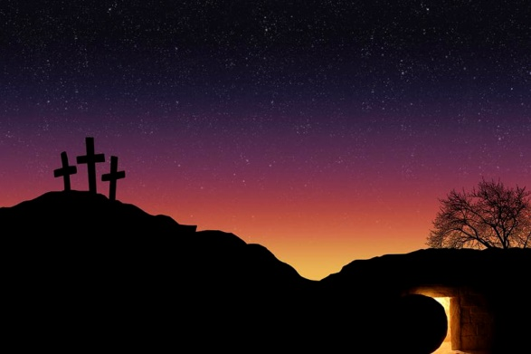
"I am He who lives, and was dead, and behold, I am alive forevermore. Amen. And I have the keys of Hades and of Death." — Revelation 1:18
I am
I am
I am
I am
Notes:
Jesus lived and died for each of us. His resurrection is the assurance of His promise.

Slide 44
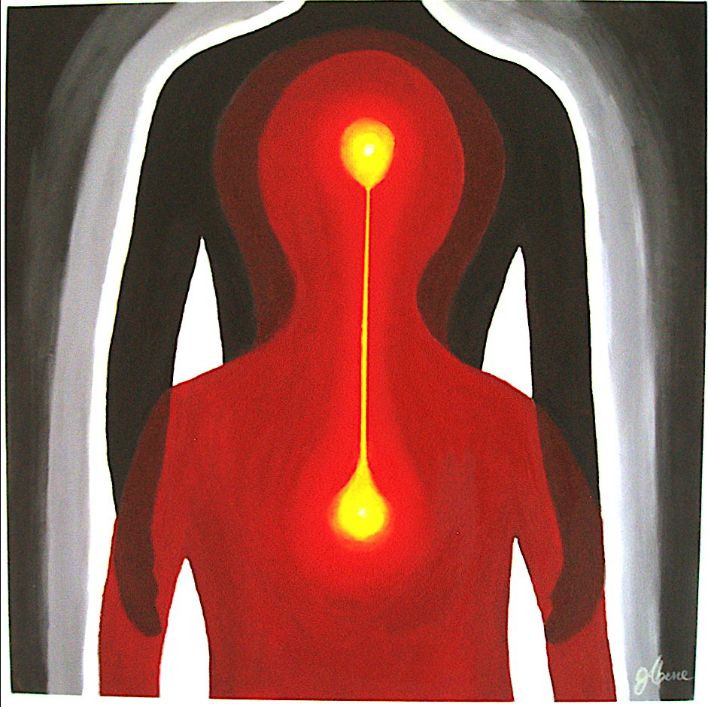
"I will kill her children with death, and all the churches shall know that I am He who searches the minds and hearts. And I will give to each one of you according to your works." — Revelation 2:23
I am
I am
searches
heart
works
Notes:
Will our hearts meet our minds in accord with His wishes for us to know Him in us? He is next to us knowing our all. Is what our mind hears buried in our hearts devoted to Him?

Slide 45
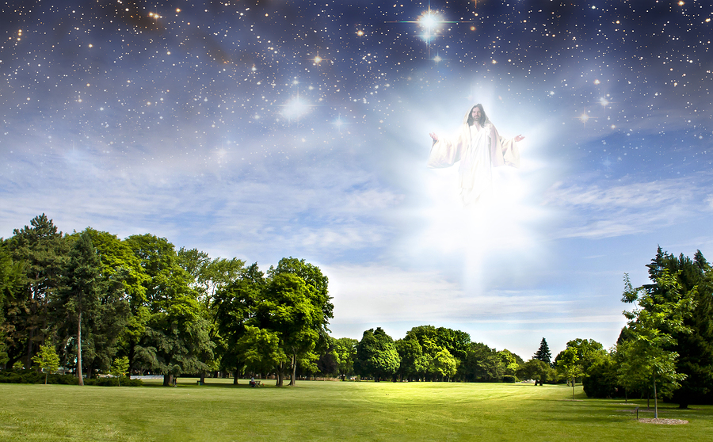
"And behold, I am coming quickly, and My reward is with Me, to give to every one according to his work." — Revelation 22:12
I am
I am
Notes:
Not much time is given for souls to decide as eternities gates come forth. Darkness sheds its’ light without regarding His brilliance to the realm of isolation. Change from that darkness to the light is the very definition of repentance that God now demands of His returning children.

Slide 46
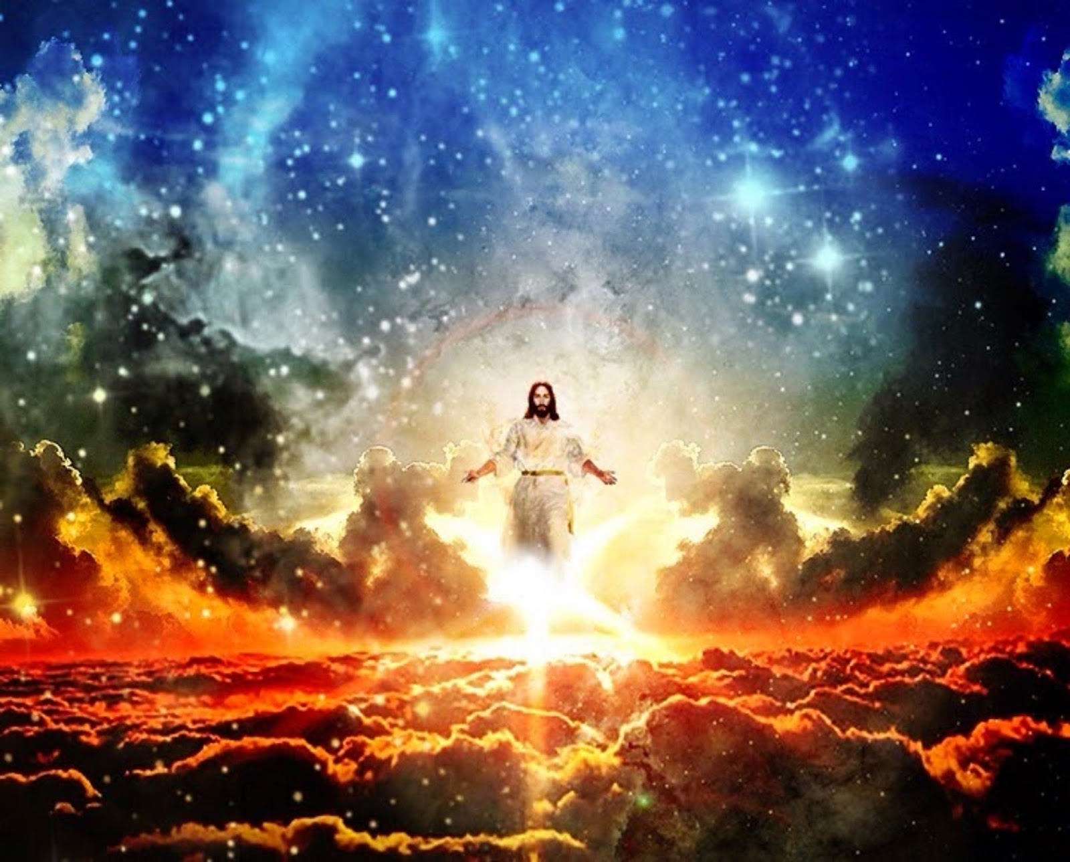
"I, Jesus, have sent My angel to testify to you these things in the churches. I am the Root and the Offspring of David, the Bright and Morning Star." — Revelation 22:16
I am
I am
Notes:
It is all transparent that no shadow may be hidden from the light He has bestowed upon all His creation. A great witnessing is occurring across the realm of life exposing truth over lies.

Slide 47
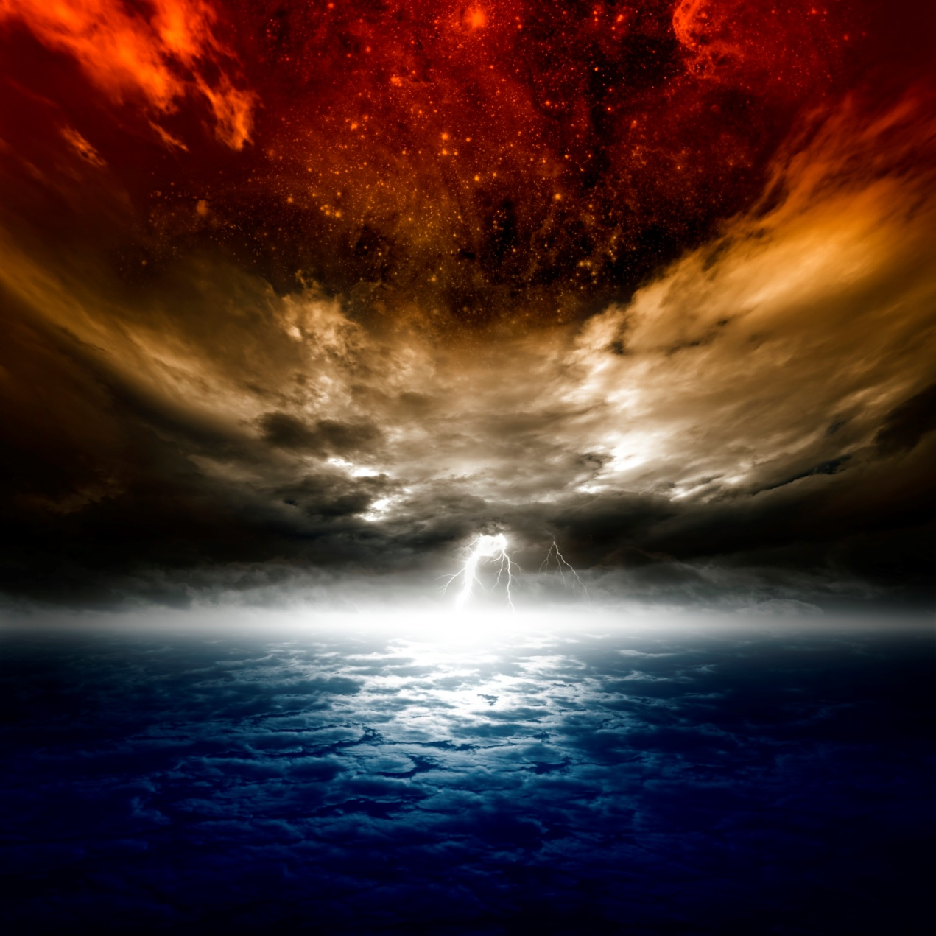
"I am the true vine, and My Father is the vinedresser." — John 15:1
I am
I am
Notes:
The juice of life all comes from one source and is what we all will return to.

Slide 48
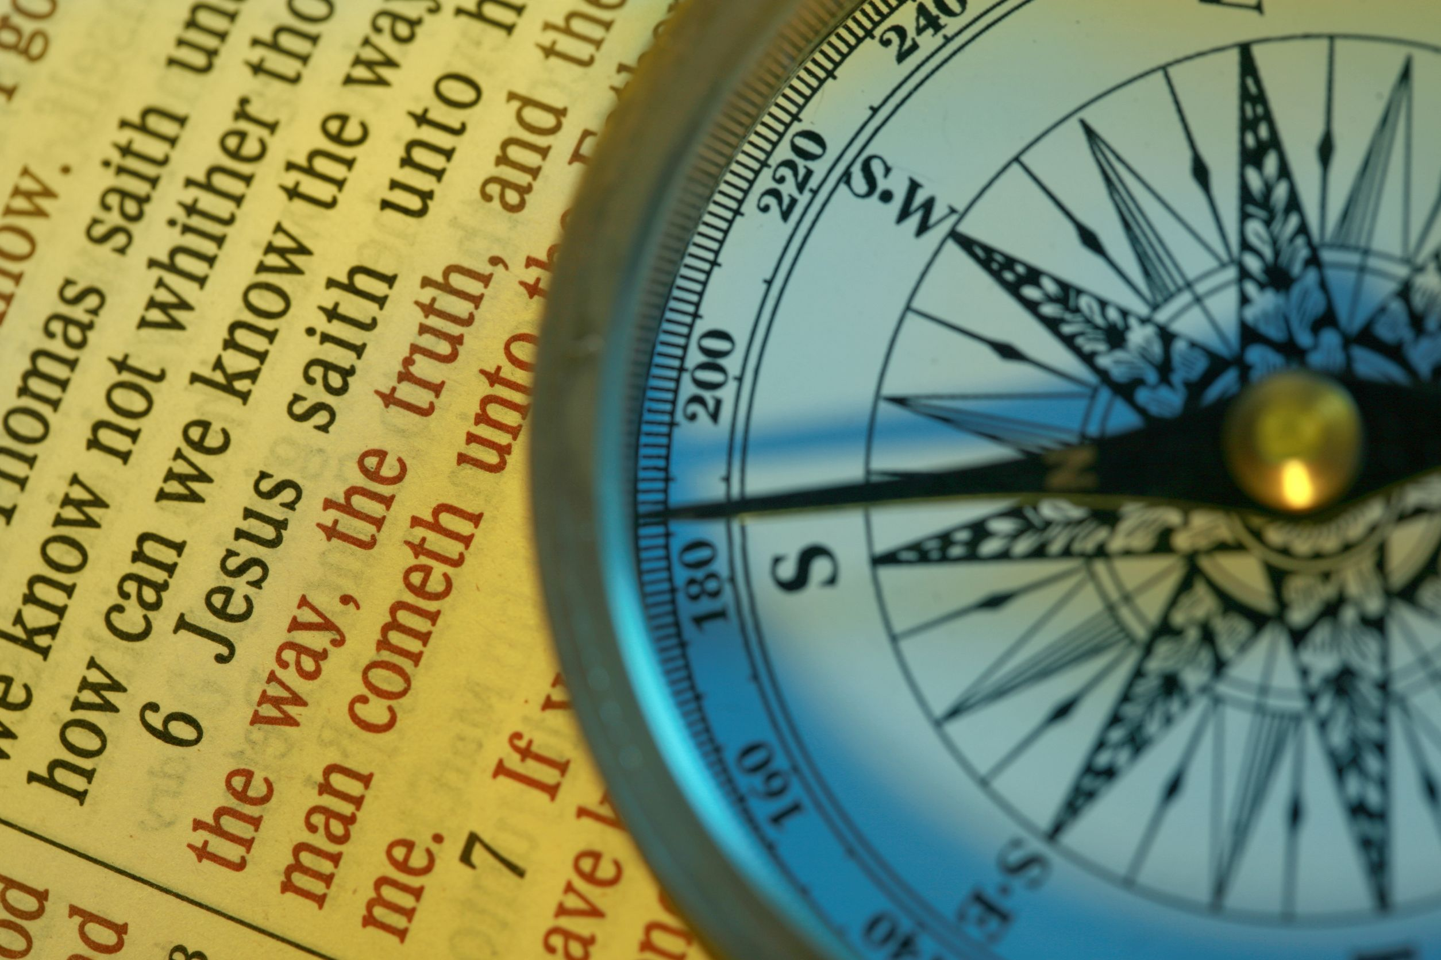
Jesus said to him, "I am the way, the truth, and the life. No one comes to the Father except through Me." — John 14:6
I am
Notes:
There is only one Lord and to His house we should all hope to enter. Do we believe, the cliché of all faith. In Him our compass is clear. Give me north straight that I might see no other. If our compass does not point through Jesus, this pointless direction has no destination.

Slide 49
→ Are You the Christ, the Son of God? Jesus said, "I am"
→ Jesus answered, "You say rightly that I am a king"
→ I am the resurrection and the life
→ I am the light of the world - I am the bread of life
→ I am there in the midst of them gathered in Me
→ I am gentle and lowly in heart - I am the door
→ I am the good shepherd - among you as 1 who serves
→ I am the true vine, and My Father is the vinedresser
→ Jesus said, "I am the way, the truth, and the life"
→ I am He who lives, & was dead, & I am alive eternally
→ I am He who searches the minds and hearts
→ I am the Offspring of David & Bright & Morning Star
→ I am coming quickly to give each according to works
Living among us He lives forevermore
Notes:
Living among us He lives forevermore.

Slide 50
Notes:
Darkness has nothing to watch.

Slide 51
Please visit http://www.LoveFromGod.com to explore further
Ronald Bert Channel on
Notes:
Eternity never ends.

